Slide 1

APACHE KAFKA
A
High throughput distributed Messaging system.

Slide 2
Introduction
Kafka is a distributed message streaming platform.
That uses publish and subscribe mechanism to stream the records.
Originally developed by LinkedIn and later donate apache foundation
Open source.
Currently used by many enterprise like LinkedIn, Netflix, uber, Twitter.

Slide 3
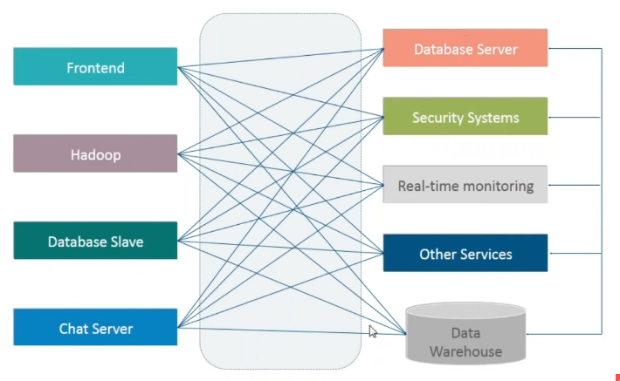
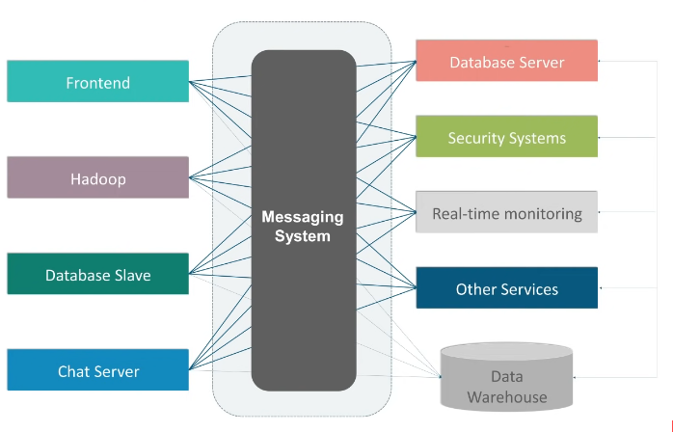
message streaming platform

Slide 4
Messaging System
Messaging system is responsible for transferring data from one application to another so the application can focus on data without getting down on data transmission and sharing.
Point to point messaging system
Massage are persisted in a queue.
There is no time dependency laid for the receiver to receive message.
When the receiver receives the message ,it will send an acknowledgement back to the sender.
Particular message can be consumed by max of one receiver only.

Slide 5
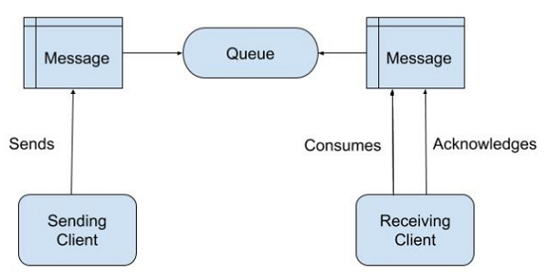

Slide 6
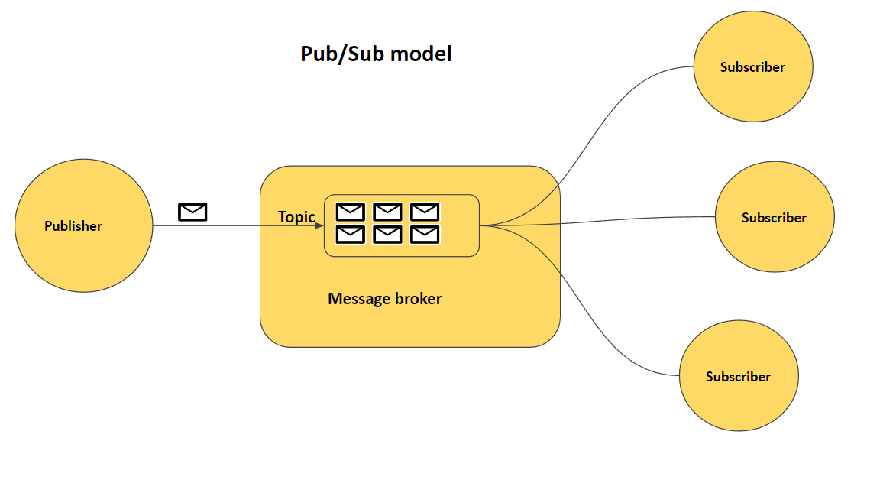
Publish-Subscribe Message System
Message are persisted in a Topics.
A particular can be by any number of consumers.
There is time dependency laid for the consumer to consume the massage .
When the subscriber receives the massage, it doesn't send an acknowledgement back to the publisher.

Slide 7
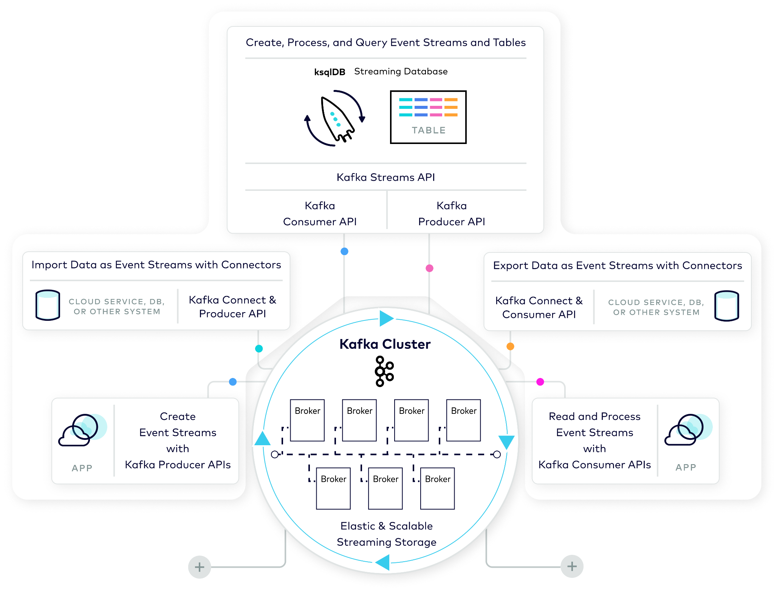
Overview of Kafka Architecture
Compute Layer
Storage Layer
Notes:
In this module, we will examine Kafka’s architecture at a fairly high level. With this in mind, if you already have experience using Kafka to satisfy data-in-motion requirements, you may prefer to skip this module and move ahead to the next module that covers Kafka’s data plane. For those that are new to Kafka or would like to stick around for a refresh, let’s begin.
Kafka is an event streaming system. The core of that is the storage layer. Designed as a distributed system. Two apis to access the storage, one for writes and the other for reads. On top of that, we build two additional apis: connection for integration and kstreams/ksql for processing.
Kafka’s design separates the storage layer from the compute layer.
The storage layer includes brokers (servers) that make up the Kafka Cluster.
The compute layer includes clients that create events, and that read and process these events.
These clients include the streaming database ksqlDB, applications that use the Kafka Streams client library, and Kafka connectors

Slide 8
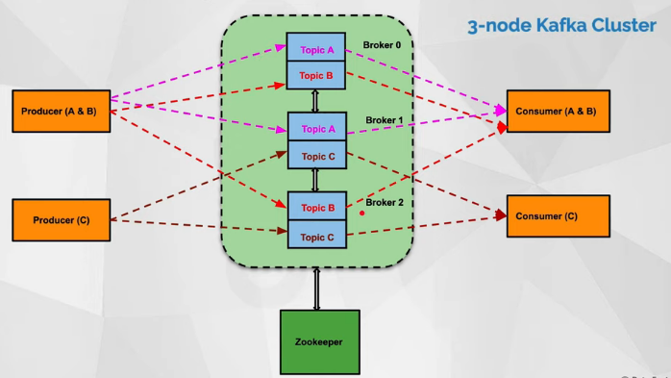
A high-level Architecture

Slide 9
Events:
Events are produced to, stored in, and consumed from an Event Stream
New events are always appended to the end of the Event Streams
Once events have been written, they are immutable.
For each event, the client builds a corresponding Kafka Record.

Slide 10
Event Processing Application
Event Source
Event Stream
Record =>
timestamp
key
value
Headers
Notes:
An event represents an immutable fact about something that happened. Good examples of events are customer orders, payments, activities, or measurements. An event shouldn’t be too large. A 10GB video is not a good event. A reference to that video is. Key is not used for random lookup like a key/value store. There are 3 use cases for key: ordering, colocating, compaction.
Designed for real time. Events can be collected and delivered in real time.
Events are produced to, stored in, and consumed from an Event Stream.
New events are always appended to the end of the Event Streams
Events are delivered to consumers in this append order
Once events have been written, they are immutable.
For each event, the client builds a corresponding Kafka Record.
This record contains all of the event details.
The client serializes the key and value fields into byte arrays.
This is how the Record is stored in Kafka.
Kafka itself doesn't know anything about the data that is being stored, or how it should be interpreted (these raw bytes = a string? an integer? JSON? ...?).

Slide 11
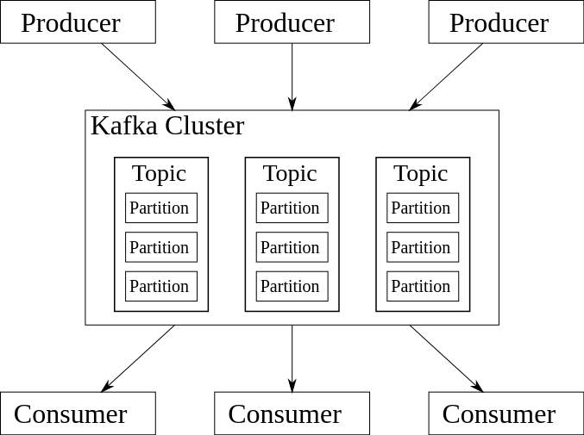
Kafka Topics
A topics is a container that typically group events of some together, like DB table ,order, finance
Kafka clusters typically contain many topics.
Unique identifier of topic is its name .
Append the new topics at the end.
a topic can only be read by seeking an arbitrary offset, then by scanning sequential entries
events in the topic are immutable

Slide 12
Events are immutable
Append only
Event
Source
Kafka Cluster
Event
Consumer
Event Stream
account-deposits
Notes:
A topic is a container that typically group events of same type together, like a DB table, order, clicks, impressions, etc. During write, specify which topic. During read, subscribe based on topic for filtering on consumption. Topic can be configured independently, e.g. how long to retain.
Kafka topics are named containers of a sequence of related events, e.g., “customer orders”, “customer account deposits”, “customer account balance updates”, and so on … Topic defines a logical queue. Consumption at topic level.
The topic is Kafka’s most fundamental unit of organization. As a developer using Kafka, the topic is the abstraction you probably think the most about.
Kafka clusters typically contain many topics.
Consumers generally subscribe at the topic level
Topics take the form of a log and as such are easy to understand, because they are simple data structures with well-known semantics.
A topic is append only: When you write a new event into a topic, it always goes on the end.
Second, a topic can only be read by seeking an arbitrary offset, then by scanning sequential entries.
Third, events in the topic are immutable—once something has happened, it is exceedingly difficult to make it un-happen.
The simple semantics make it feasible for Kafka to deliver high levels of sustained throughput in and out of topics, and also make it easier to reason about the replication of topics, which we’ll cover in more detail later.
Kafka topics are also fundamentally durable things. Traditional enterprise messaging systems have topics and queues, which store events temporarily to buffer them between source and destination.
Since Kafka topics are logs, there is nothing inherently temporary about the data in them. Every topic can be configured to expire data after it has reached a certain age (or the topic overall has reached a certain size), from as short as seconds to as long as years or even to retain events indefinitely. The logs that underlie Kafka topics are files stored on disk. When you write an event to a topic, it is as durable as it would be if you had written it to any database you ever trusted.
The simplicity of the topic and the immutability of the contents in it are key to Kafka’s success as a critical component in modern data infrastructure—but they are only the beginning.

Slide 13
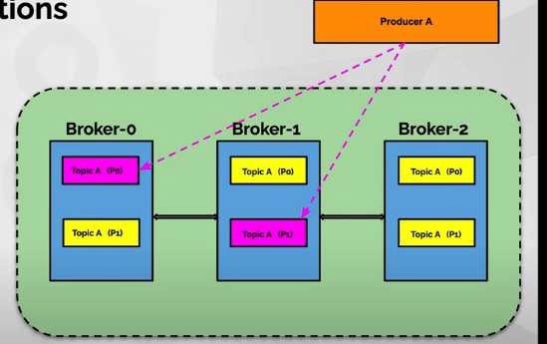
Topics-Partitions
Each partition’s data is stored on a single broker
Topics creation:
No of partitions
Replication factor
Retention periods(7days)
Replication factor less than equal to number of brokers.
Leader(pink) and Follower(yellow)
Writes to leaders
One of the followers become leader when containing that partition fails

Slide 14
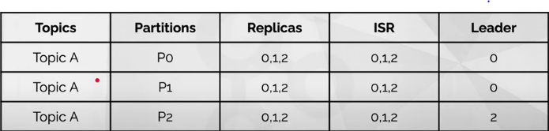
Terminology of partitions and replicas
Topic A created with 3 partitions and with a replication factor 3 on a 3-broker Kafka cluster (Broker-0,Broker-1 and Broker-2)

Slide 15
Topic Partitions
Kafka Cluster
Kafka Cluster
Broker
Broker
Broker
Broker
Broker
Broker
partition 1
partition 2
partition 0
partition 1
partition 2
partition 0
account-deposits
account-deposits
account-deposits
account-deposits
account-deposits
account-deposits
partition 4
account-deposits
(AWS S3, Google Cloud Storage)
Notes:
Since Kafka runs as a distributed system, we need a way to distribute the data in a topic to the cluster. Partition is the unit of distribution. Each partition’s data is stored on a single broker. There are typically many partitions for LB. Partition is also the unit and parallelism for better scalability. A partition’s storage is typically bounded by a capacity of a single broker. With tiered storage, a partition’s data can be infinite.
If a topic were constrained to live entirely on one machine, that would place a pretty radical limit on the ability of Kafka to scale. It could manage many topics across many machines—Kafka is a distributed system, after all—but no one topic could ever get too big or aspire to accommodate too many reads and writes. Fortunately, Kafka does not leave us without options here: It gives us the ability to partition topics. In practice, almost all topics are partitioned.
Partitioning takes the single topic and breaks it into multiple topic partitions, each of which can live on a separate node in the Kafka cluster. This way, the work of storing events, writing new events, and processing existing events can be split among many nodes in the cluster.
And with tiered storage which was recently introduced by Confluent, a single topic partition does not have to fully fit on a Kafka broker. Instead, it can be split between the Kafka broker and object storage. For now, hold on to that thought until we discuss Tiered Storage in more detail later in the course.

Slide 16
Partition Offsets
Kafka Cluster
Broker
Broker
Broker
Offsets increase monotonically
The first event is offset 0
partition 0
partition 1
partition 2
0
1
0
1
2
3
0
1
2
3
4
account-deposits
account-deposits
account-deposits
(AWS S3, Google Cloud Storage)
Notes:
Each event in a partition has a unique identifier, called offset. It’s monotonically increasing and never reused. Consumer typically asks for new events from an offset. Events delivered to consumer in offset order.
Offsets are logical id of records.
When events are written to a partition, they are assigned an offset identifying the logical position within the partition. Partitions and offsets allow efficient offset management.
The first event written to each partition is assigned offset 0
Subsequent events written to partitions are assigned the next corresponding offset for that partition

Slide 17
Broker
Broker are simple software process who maintain and manage the published message.
Also known as Kafka server and bootstrap server.
Default port 9092.
All brokers communicate among one another inter-broker communication
It also manage the consumer-offset and are responsible for the delivery of message to the right consumer.
A set of the brokers knows all brokers ,topics and partitions (metadata) for management and maintenance.
We can add more brokers in a already running Kafka cluster without any downtime.

Slide 18
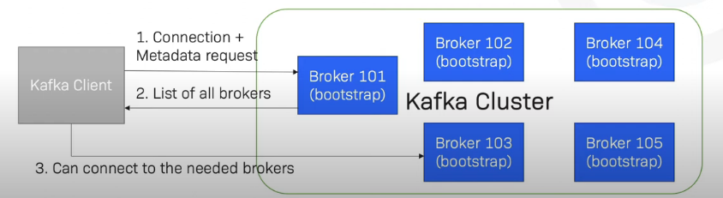
The two request in broker: produce requests from the producer for writing events and fetch requests from the consumer and other replicas for reading events.
Producer clients send produce requests containing events
Brokers write these events to topic partition logs.
Consumer clients send fetch requests for events they need to process.

Slide 19
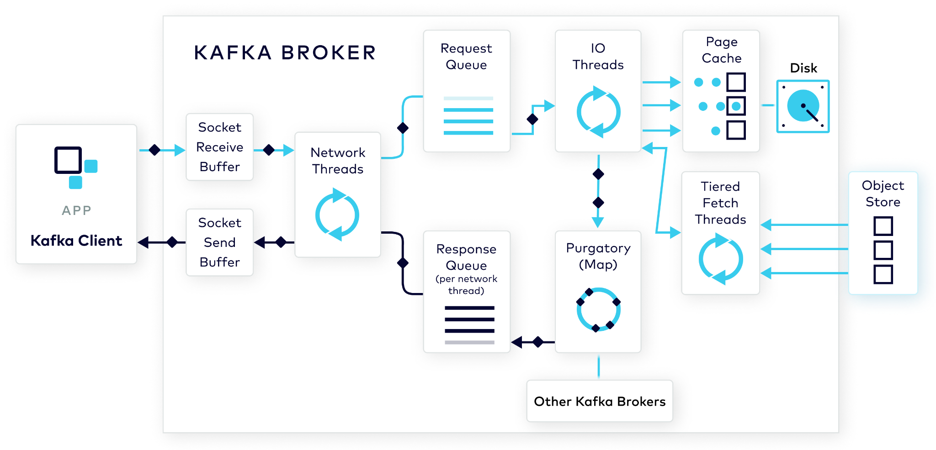
Inside The Apache Kafka Broker
Broker
Broker
Broker
Broker
Broker
Broker
Notes:
There are two basic requests the broker processes related to these event: produce requests from the producer for writing events and fetch requests from the consumer and other replicas for reading events. All of these requests go through the same basic steps as they are processed by the broker that receives the request.
When we speak about Kafka data, we are referring to the events that are written to and stored by brokers in the cluster.
Producer clients send produce requests containing events.
Brokers write these events to topic partition logs.
Consumer clients send fetch requests for events they need to process.
Other brokers send replica fetch requests to partition leaders for events that they need to replicate to follower replicas.
Before we examine this request loop in more detail, let’s first look at the steps a producer client goes through in building a produce request.

Slide 20
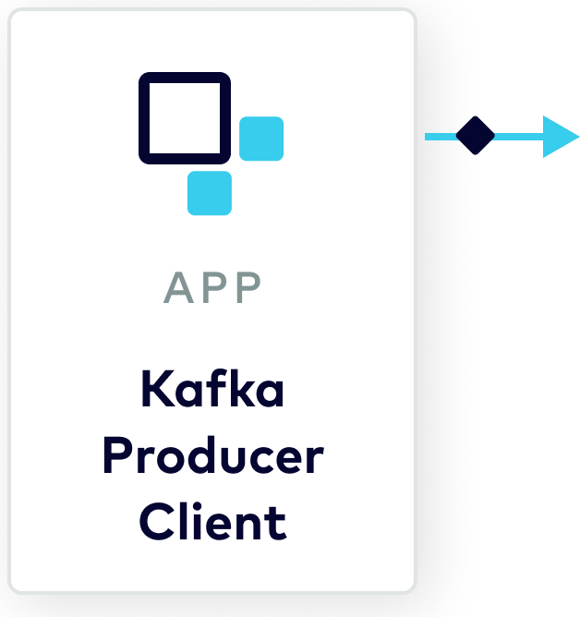
Assign Record to Topic Partition same key and same partition through hashing. If key not specified it goes round-robin for next
Record =>
timestamp
key
value
Headers
Notes:
Let’s start from the producer. Producer sends a record to a topic. Client library maps to the record to a partition within that topic. By default, if a record has key, the record is deterministically mapped to the same partition through hashing. If there is no key, the record is sent to a partition in a round-robin way.
The Kafka producer client first assigns each record to a specific topic partition based upon the contents of the record and the partitioner that the producer is configured to use. Partitioner based on the key to map record to partition.
The default partitioner does this using a hash of the key modulo the number of partitions in the topic, the result being the partition number the record is assigned to.

Slide 21
Records Accumulated into Record Batches Records are compressed as they are added to the Record Batch. batching favors low latency or high throughput
RecordBatch =>
…
…
attributes: int16
bit 0~2:
0: no compression
1: gzip
2: snappy
3: lz4
4: zstd
…
…
records: [Records]
Record =>
timestamp
key
value
Headers
Compression
Record 1
Record 2
…
Record n
Notes:
Sending each record as a separate PRC request has too much overhead. Instead, the producer client first accumulates the record in a buffer associated with to the partition. Another benefit of batching is to make compression more efficient.
The producer can be tuned so that this batching favors low latency or high throughput
If the client is configured to use compression, records are compressed as they are added to the RecordBatch.
The combination of batching and compression reduces network bandwidth and cluster storage requirements.

Slide 22
Records Batches Drained into produce request
Batch.size()
batch.size is the maximum number of bytes that will be included in one batch. deafult 16kb.
100KB, then it won’t be batched. E.g: 5 flight request in esewa at same time .batching together while wait ,ack and come back and kafka send whole batch at once. minimize latency.
Linger.ms()
the number of milliseconds a producer is willing to wait before sending a batch out. Default it is zero.
Linger.ms=5 ,it expense of small delay.

Slide 23
Network thread ,request queue and I/O thread
Network Thread
network thread is used for multiplexing different client connections.
request handling, it mostly converts the bytes in socket buffer into a request and put it into a shared request queue.
It enforces the ordering of requests .one request at a time .
Request Queue
There is a single request queue per broker .
one response queue per network thread
I/O Threads
It can pick any request from any client.
It verifies the CRC of the data and then append the data to the destination topic partition in the file system through page cache.
verifies the starting sequence number for the record batch is the next expected for the producer ID. Ordering guaranteed within broker.

Slide 24
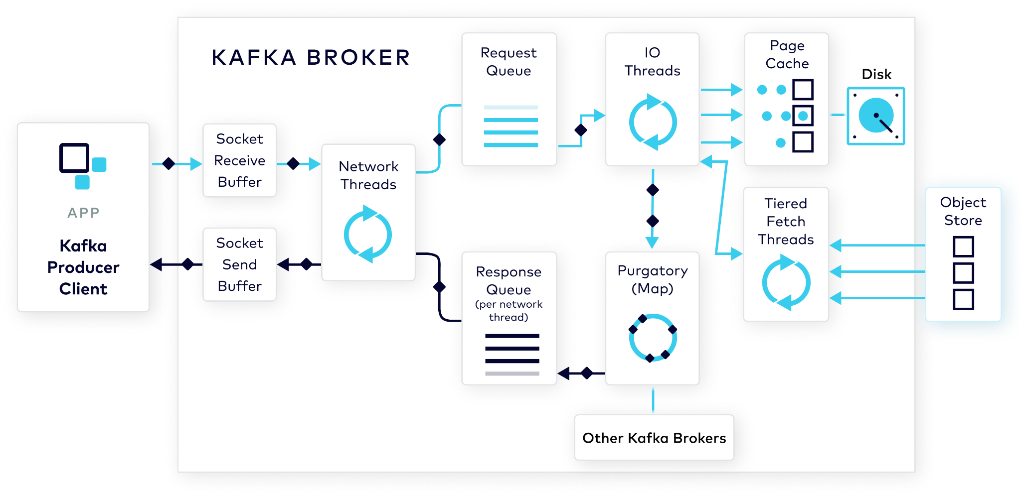
Network Thread Adds Request to Queue
Notes:
The produce request first lands in the socket buffer on the broker. From there, it will be picked up by one of the network threads. The client connection then sticks to this network thread. The same network thread will be used for processing the request/response for the lifetime of this client connection. Since network thread is used for multiplexing different client conections, it’s designed to be light weighted. For request handling, it mostly converts the bytes in socket buffer into a request and put it into a shared request queue.
When the ProduceRequest is received by the broker, it is added to the socket receive buffer allocated by the OS kernel for the inbound network socket.
It waits there to be handled by a network thread.
When a network thread is available, it is added to the broker’s request queue.
There is a single request queue per broker but there is one response queue per network thread, since we since we want the same network thread that receives the request to handle the corresponding response.

Slide 25
IO Thread Verifies Record Batch And Stores
Notes:
A pool of IO threads dive into the request queue and picks up the next request for processing. Unlike network thread, IO thread can pick any request from any client. The IO thread does the actual work. It verifies the CRC of the data and then append the data to the destination topic partition in the file system through page cache.
Once the producer request works its way to the top of the request queue, the next available IO thread picks it up and processes it. IO threads
The IO thread checks the included record batches for idempotency and verifies their sequence numbers have not been previously received for the associated producer ID.
This is what allows Kafka to guarantee event idempotency.
It also verifies the starting sequence number for the record batch is the next expected for the producer ID.
This is how ordering is guaranteed within the broker.
If these verification tests succeed, the thread writes the record batches to the destination topic partition in the file system.

Slide 26
Kafka storage
Each topic partition exists on disk as physical files
.log is actual data and .index is mapped from offset position of log file.
If an application that uses Kafka transactions is writing events to the topic, there will be a transaction index file for each log segment.
This index contains all of the aborted transactions for the partition and is used by the broker to respond to fetches with READ_COMMITTED isolation.
Once an event is written to the log, it is immutable and never changes.

Slide 27
Kafka Physical Storage
/var/lib/kafka/data/account-deposits-1
00000000000047926734.log
00000000000047926734.index
...
00000000000052497535.log
00000000000052497535.index
...
Notes:
Each partition organizes its data into segments, designated by the starting offset. The data is appended to the end of the .log file in the latest segment. Once the segment has enough data, it’s rolled into an immutable one and a new empty segment is created. Each segment also has a sparse index that maps offsets to file positions, which makes it easy to locate a record offset from the log file.
Each topic partition exists on disk as physical files.
For each partition log segment, there is a set of these files.
The file name for each is equal to the initial record offset for the segment.
The .log file extension identifies the log segment.
Each log segment has a corresponding index that associates record offsets with a physical position in the log file.
It also has a time index that associates timestamps with offsets.
If an application that uses Kafka transactions is writing events to the topic, there will be a transaction index file for each log segment.
This index contains all of the aborted transactions for the partition and is used by the broker to respond to fetches with READ_COMMITTED isolation.
The segment that was most recently created is the active segment.
New events are appended to the end of the active segment.
This append only nature of the log deserves emphasis.
Once an event is written to the log, it is immutable and never changes.

Slide 28
Purgatory
the broker only acks the producer once the data is fully replicated to other brokers.
While waiting, we don’t want to tie up the IO thread since it’s limited
Once the replication completes or the timeout is reached, the pending request is taken out of the purgatory.
Purgatory is a special data structure, known as a hierarchical timing wheel, that buffers requests while the events are replicated.

Slide 29
Purgatory Holds Requests Being Replicated
Notes:
By default, the broker only acks the producer once the data is fully replicated to other brokers. While waiting, we don’t want to tie up the IO thread since it’s limited. Instead, we stash the pending request in a Purgatory structure, a bit like a map. The IO thread is then freed up for processing the next request. Once the replication completes or the timeout is reached, the pending request is taken out of the purgatory.
The next step in the request processing loop is replication and purgatory.
Once events have been written to the local partition log, they can be replicated.
Depending upon the topic’s replication setting, other brokers will fetch the events and write them to their local replica of the topic partition.
The client request tells the broker when it should send the request response.
If the client request tells the broker it should wait for the replication to complete before sending the request response, the request waits in purgatory until the replication has completed.
Purgatory is a special data structure, known as a hierarchical timing wheel, that buffers requests while the events are replicated.
The reason to have purgatory is to stash pending requests so as to not tie up the IO threads, which are limited.

Slide 30
Response Added to Socket Send Buffer
Notes:
Once the request is taken out of purgatory, broker generates a response and put that into the response queue. The network thread picks it up and send the data to the socket send buffer. There is one response queue per network thread. So that the same network client is used for processing the response. Network thread also ensures requests from the same client are processed in order.
The last part of the broker request cycle is sending a request response.
Each network thread handles a separate response queue. When the broker completes processing the request, the request response is added to the response queue tied to the network thread that initially processed the request.
When the request reaches the top of the response queue, it is added to the socket send buffer by the network thread.
If the client connection uses TLS, the response will first be encrypted.

Slide 31
Fetch Request
If no new data is available in topics, sending empty response continuously is not efficient.
One condition is that a minimum quantity of event data in bytes has been retrieved from the topic and added to the response.
The second condition is the time the response has been in the response queue satisfies the max wait period
Network thread uses zero-copy transfer to send data from file to socket directly

Slide 32

Fetch Requests
Contiguous fetch ranges are calculated
Data is (zero) copied to the send buffer
Fetch from object storage (if not available locally)
Notes:
The steps for consumer fetch requests and replica fetch requests received from other brokers are similar to produce requests with a few exceptions. The IO thread uses the offset index to quickly find the byte range in the log file. The usage of purgatory is also different. If no new data is available, sending empty response continuously is not efficient. So, the broker ensures minimal bytes is available. Otherwise, put the fetch request to Purgatory and wait up to max wait time. Network thread uses zero-copy transfer to send data from file to socket directly. Normally this is fast since data is still in page cache. Occasionally, if the data is not in page cache, the transfer can block network thread and impact other clients. Tier storage addresses this issue.
Avoiding blocking I/O in network threads through tier storage.
Instead of writing events to page cache, the IO thread satisfies the fetch request by retrieving events from the specified topic partition.
With respect to purgatory, the fetch response remains there until either of two configured conditions are satisfied:
One condition is that a minimum quantity of event data in bytes has been retrieved from the topic and added to the response.
The second condition is the time the response has been in the response queue satisfies the max wait period
This is an either or condition. As soon as either of these conditions is met, the fetch response is no longer held in purgatory.
Another subtle distinction between the produce request cycle and the fetch request cycle is in the network thread.
In Kafka we use zero copy transfer to transfer the bytes from a file on the broker all the way to the consumer client.
In the normal case this can be done very quickly because most fetch requests are close to real time and the data is still sitting in the page cache.
Occasionally if you are fetching some really old data, it potentially needs to be fetched from the disk, which can block the network thread for some time.
This will impact other clients who are assigned to the same network thread.
Infinite storage in CCloud solves this problem.
Older data resides in remote storage instead of local storage.
When this older data is requested, the fetch from remote storage is done async and doesn't block the network thread.
You should now have a better understanding of how the Kafka broker processes client requests to write events to and read events from Kafka topics.
In the next module we will examine how the Kafka replication protocol is used to provide event data durability and availability and fault tolerance.

Slide 33
Controllers
One of the brokers of a Kafka cluster
Responsible for the administration of the partitions.
For example,
Decides which replica should become the leader for each partition.
Tracks the state of each partitions(Online, offline, deleted, partition new partition, partition deleted )
Elected by the Zookeeper.

Slide 34
Zookeeper
Application running separately outside of Kafka cluster.
More than zookeepers are allowed , then all of the work together as zookeeper cluster.
Default port is 2181
Metadata management
Tracks the state of Kafka brokers(alive brokers, crashed broker etc)
Elects a new controller whenever a brokers fails.
Contain the metadata information List of topics and number of partitions for each topic. Location of all the replicas for each topics parition. Information about ACL(Access Control Lists)

Slide 35
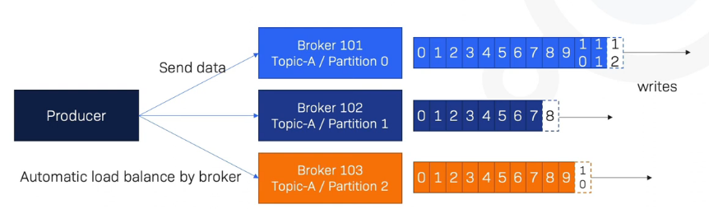
Producers
Producer are write/publish data to the topics within cluster using the producing APIS.
Producer can write data either on the topic level (All the partition of that topics ) or specific partitions of the topic.
Producer can choose to receive ack of data writes acks=0:Producer wont wait for ack(possible data loss) acks=1:producer will wait for leader ack(limited data loss) acks=all: Leader + replicas ack(no loss data)

Slide 36
Acknowledgement
The number of acknowledgements the producer requires the leader to have received before considering a request complete may vary.
Producer property to be set acks acks=0 acks=1 acks=all
This controls the durability of records that are sent .

Slide 37
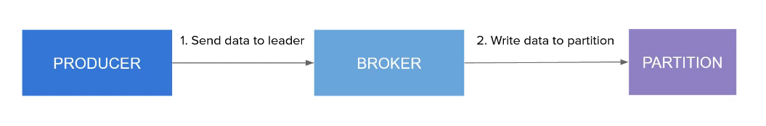
Acks=0
The producer will not wait for any acknowledgment from the server
No guarantee can be made that the server has received the record
High performance
Possibility of data loss
Useful when its ok to potentially lose data: log collection

Slide 38
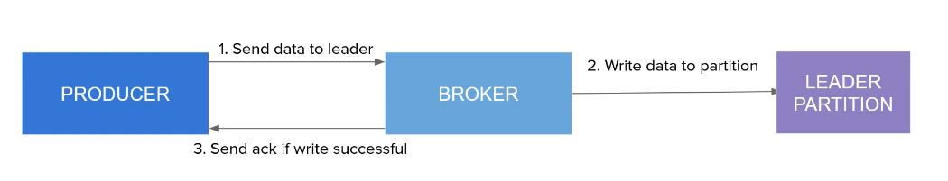
Acks=1
Acknowledgement sent once data is written to the leader partition
No guarantee for data being replicated to ISRs
If an ack is not received, the producer may retry
Data loss possibility in case the leader goes down but the data is not yet replicated to ISRs

Slide 39
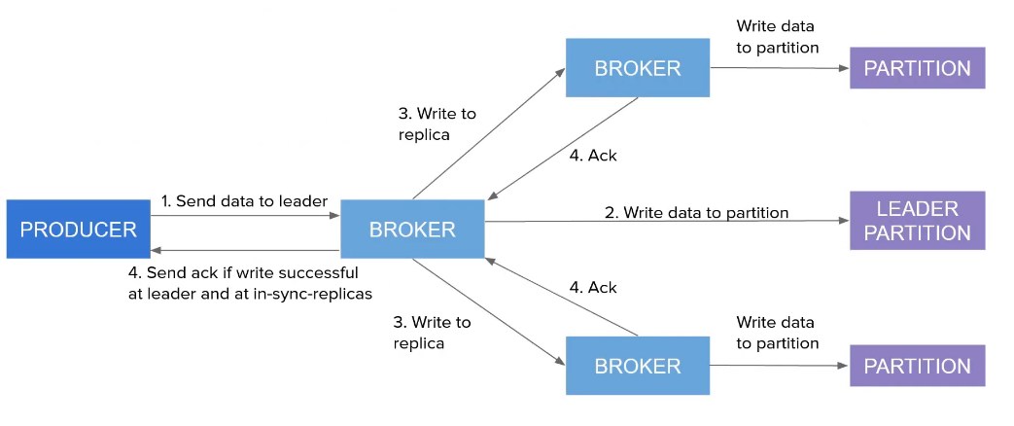
Acks=all
The leader will wait for the full set of in-sync replicas to acknowledge the records. confluent default ack
More latency and more safety
No data loss as long as ISR is alive .

Slide 40
Min.insync.replicas
When a producer sets acks to all ,min.insync.replicas specifies the minimum number of replicas that must acknowledge a write for the write to be considered successful. 10,replicas,min.insync.replicas=2,write successful if data is written to leader and any 2 ISR
If minimum cannot be met, then the producer will raise an exception (notenoughreplicas).
Combination of both provide durability guarantees.

Slide 41
Retrying to produce messages
In case of transient failures (Notenoughexception), developers are expected to handle exceptions, otherwise the data will be lost.
Retries: Number of times to retry a request that failed for potentially transient reason.
Setting a value of greater the zero for this property will cause the client to send any request that fails with transient error.
It is recommended that rather than control the number of retries, we should control for how long a client should retry request.in this case retries can be set to a very large value.

Slide 42
Retrying with timeouts
Retry.backoff.ms(=100 ms) is the amount of time to wait before attempting to retry a failed request to a given topics partition.
Delivery.timeout.ms(defaults to 2 mins) is the maximum amount of time for which the producer will attempt to retry a failed request.
If retries are enable there are failed sends, there is a risk of massage re-ordering due to retries. Two request are sent to single partition. First fails and is retried. Meanwhile the 2nd one is already written to the partition After the retry the first one is also written to the partition but order is messed up

Slide 43
Max.in.flight.request.per.connection
Max.in.flight.request.per.connection(=5) the maximum number of unacknowledged request the client will send on a single connection before blocking.
Is set =1 will ensure ordering but will reduce throughput
Enable.idemoptence
When it set to true the producer adds a unique sequences number to message. duplicate check
Refrance: https://kafka.apache.org/documentation/#producerconfigs

Slide 44
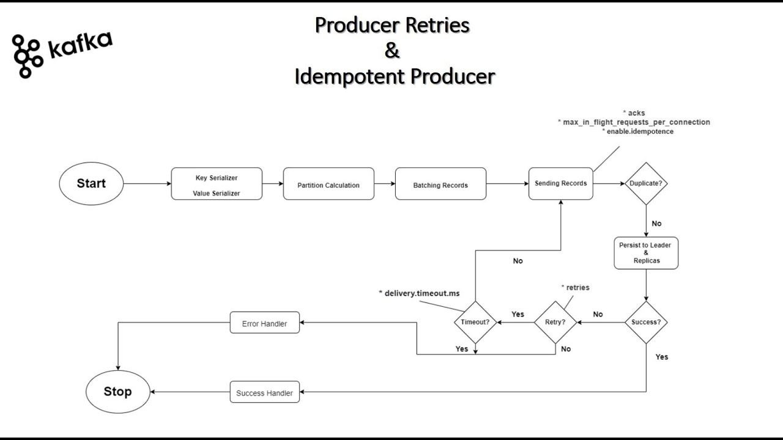

Slide 45
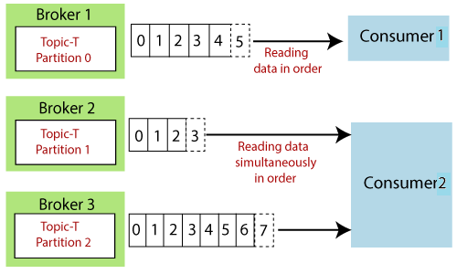
Consumers
Consumer are the application which read/consume data from the topics within a cluster using the consuming APIs.
Consumer can read data either on the topic level (All the partition of that topics ) or specific partitions of the topic.
A consumer group is a group of related consumer that perform a task.
Note: offset 2 under broker 2 doesn't have any connection with the data contained in offset 2 under broker 3

Slide 46
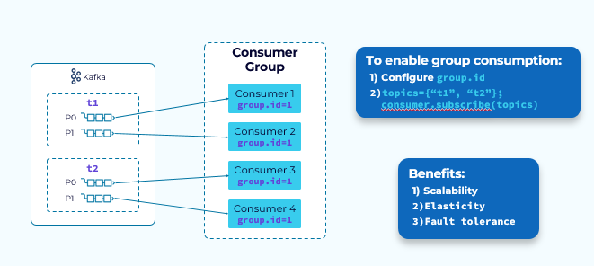
Kafka Consumer Group

Slide 47
Consumer Group
Max no of consumer in a group is equal number of partition.
First member who joined the group is leader.
Who is chose group co-ordinate ?
Chosen Leaders of internal offset topic, __consumer_offsets ,which is used to store committed offset.
Who create the consumer group?
new random consumer group is created with the name console-consumer-<some_random_number> and the consumer automatically falls under this consumer group

Slide 48

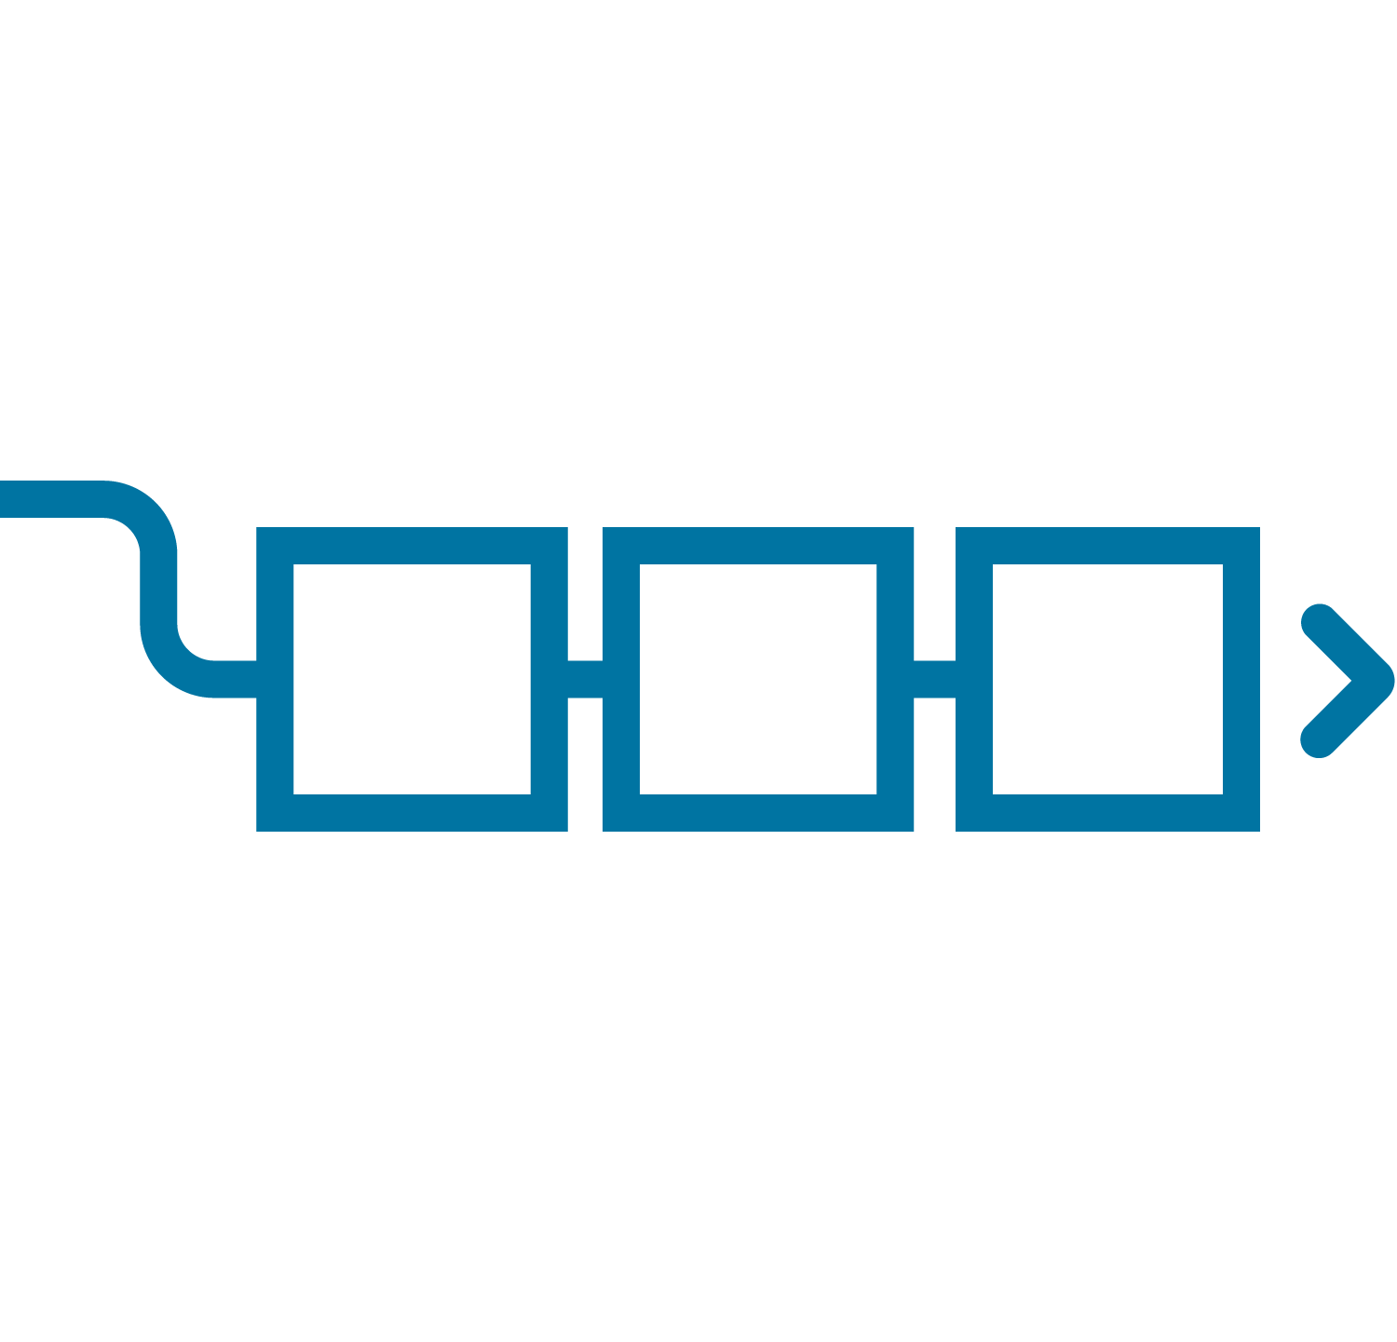
Group Coordinator
Broker
Group Coordinator
Consumer Group
__consumer_offsets
Consumer 1
group.id=1
Group coordinator determined by group.id
Consumer 2
group.id=1
Broker
Group Coordinator
__consumer_offsets
Consumer Group
Consumer 1
group.id=2
Broker
Group Coordinator
Consumer 2
group.id=2
__consumer_offsets
Notes:
The workhorse behind Consumer Groups is the Group Coordinator. Coordinator helps coordinate the consumers in the group and distribute the load evenly among consumers. Multiple coordinators to balance the load. An internal topic is used to store group metadata.

Slide 49
Group Startup: Step 1 - Find Group Coordinator
Sent to any broker
Consumer Group
Broker
FindCoordinator(groupId)
Consumer 1
group.id=1
__consumer_offsets
coordinator endpoint
Broker
Group Coordinator
__consumer_offsets
Consumer 2
group.id=1
coordinator endpoint
Broker
FindCoordinator(groupId)
__consumer_offsets
Notes:
Consumers find their group coordinator by sending a FindCoordinator request to any broker in the cluster. Broker hashes the group.id and deterministically find a partition (50 in total) in internal topic. The leader of that partition is the group coordinator. Internal topic is a pattern that will be used in many places.
The broker determines a partition number using a hash of the group.id modulo the number of partitions in the __consumer_offsets topic.
The current leader of that partition is the group coordinator for consumers assigned that group.id.
The find coordinator response contains the endpoint for that group leader.
This allows the coordination for different consumer groups to be distributed.

Slide 50
Group Startup: Step 2 - Members Join
Broker
Consumer Group
Consumer 1
group.id=1
group leader
topic-a
JoinGroupRequest
(subscription)
Broker
JoinGroupResponse
(memberId, member list & subscriptions)
Group Coordinator
__consumer_offsets
JoinGroupRequest
(subscription)
Consumer 2
group.id=1
Broker
JoinGroupResponse
(memberId)
topic-a
Notes:
Challenge: want to make the partition assignment strategy pluggable in the consumer. So, the coordinator picks one of the consumers (typically first one joining the group) as the group leader. Group leader allows the decision on partition assignment to be made deterministically. Allow partition assignment to be customized in the client.
Let’s now walk through how a consumer group starts.
For the purposes of this walk through, a single group coordinator is shown on one broker and topics that the consumers will subscribe to are shown on the other two brokers.
This highlights the fact that the location of the group coordinator is in no way related to the location of topics that the consumer group subscribes to.
As mentioned previously, the group coordinator location is solely based upon the location of the __consumer_offsets partition that matches up with the consumer group group.id.
When consumer instances are started, they send a join request to the group coordinator
Upon receiving the initial request, the group coordinator waits a configurable amount of time for additional members to join the group before proceeding.
After the wait period has expired, the group coordinator elects a partition assignment strategy from those provided by consumers that joined the group.
In most scenarios, all consumers in a group provide the same single strategy and it is elected.
The group coordinator assigns the first instance that joins the group as the group leader and delegates the partition assignment task to it, sending it the topic subscription details for the group.
The group coordinator also persists group info to the __consumer_offsets topic.
This info is then available if the broker fails and the group coordinator fails over to another broker.

Slide 51
Group Startup: Step 3 - Partitions Assigned
Broker
Consumer Group
Consumer 1
group.id=1
group leader
topic-a
SyncGroupRequest
(memberId, group partition assignments)
Broker
SyncGroupResponse
(assignment)
Group Coordinator
__consumer_offsets
SyncGroupRequest
(memberId)
Consumer 2
group.id=1
Broker
SyncGroupResponse
(assignment)
topic-a
Notes:
Group leader makes assignment based on configured strategy and include that in the SyncGroup request. Partition is the unit of parallelism and assignment. Group members next send a sync group request with the assigned member id and gets back its assignment.
The sync group request from the group leader includes the partition assignments for each group member.
The sync group responses sent to each member include its respective partition assignments.
The consumer instances then fetch and process events from their assigned partitions.

Slide 52
Range Assignor
It is the default strategy.
The aims of this strategy is to co-localized partitions of several topics
to join records from two topics which have the same number of partitions and the same key-partitioning logic.
first put all consumers in lexicographic order using the member_id assign
Examples:
C1={C-p0, O-p0}, c2={C-p1, O-p1}

Slide 53
Range Partition Assignment Strategies
Kafka
Consumer Group
P0 from both topics
Consumer 1
customers
P0
Consumer 2
P1
P1 from both topics
Consumer 3
orders
P0
Consumer 4
P1
Idle instances
Consumer 5
Notes:
Range is useful for co-partitioning across topics. Records with same key from both topics routed to the same consumer. Useful for processing like joins. Downside is reduced parallelism.
There are four partition assignment strategies available
The RangeAssignor is used when tracking a given key across multiple topics is necessary
To get the desired results, the topics must be co-partitioned
Co-partitioned topics have the same number of partitions and are produced using the same partitioner.
This allows the RangeAssignor to assign the same partition number from each subscribed topic to the same consumer instance as highlighted on the diagram. Consumer 1 is assigned partition 0 from both topics and consumer 2 is assigned partition 1 from both topics.
The result is that the RangeAssignor guarantees all records for a given key value are processed by the same consumer instance.
This sample RangeAssignor scenario also illustrates that scaling out a consumer group that uses the RangeAssignor partition assignment strategy is limited by the number of partitions in the individual topics.
In this case, each topic has 2 partitions so consumer instances 3, 4, and 5 are idle.

Slide 54
Round Robin and sticky partition Assignor
distribute available partitions evenly across all members.
maximizing the number of consumers used
it does not attempt to reduce partition movements when the number of consumers changes (i.e. when a rebalance occurs : join in group and leaving:revoked ).
Sticky partition Assignor:
try to minimize partition movements between two assignments, all while ensuring a uniform distribution

Slide 55
Round Robin and Sticky Partition Assignment Strategies
Kafka
Consumer Group
Consumer 1
customers
P0
Consumer 2
P1
Even distribution of partitions
Consumer 3
orders
P0
Consumer 4
P1
Consumer 5
Idle instance
Notes:
The RoundRobin strategy is used when performing stateless operations on records from many topics and partitions. Allows more parallelism. The Sticky strategy is similar to RoundRobin but makes a best effort to maintain partition assignments across rebalances.
Partitions are assigned to consumers in a round robin fashion.
This sample RoundRobin scenario illustrates that scaling out a consumer group that uses the RoundRobin partition assignment strategy is limited by the total number of partitions in the individual topics. In this case, the total number of partitions is 4 so consumer instance 5 is idle.
We will see how it does this later in the section that covers the consumer group rebalance process later in this module.

Slide 56
Tracking partition consumption
Last consumer offset it has consume.
Consumer group is restarted lastcommitedoffset and resume the consumption.
Consumer is restart is very first time ,no save position and start consumption from beginning.
Group-coordinator failover
Internal offset commit topic is replicated through group coordinator. if fails new leader in group coordinator.
Only the leader revoke (p2 is leader)

Slide 57
Tracking Partition Consumption
Broker
Consumer Group
Consumer 1
group.id=1
poll( )
topic-a
key | group.id, topic, partition
value | offset number
Broker
CommitOffsetRequest
Group Coordinator
__consumer_offsets
Consumer 2
group.id=1
poll( )
Broker
topic-a
Notes:
Consumers must track and persist their progress processing the events they fetch from Kafka topics. Records delivered in offset order per partition, which allows efficient offset management.
This knowledge is needed when a different consumer is assigned the topic partition.
Consumers accomplish this by regularly committing the next offset to be fetched to the __consumer_offsets topic
The consumer does this by sending an offset commit request to the group coordinator
The group coordinator writes the corresponding offset commit event to the __consumer_offsets topic
This event has a key of group.id, topic name, and partition number and a value of the offset number being committed.
The key makes this committed offset unique to a specific consumer group.

Slide 58
Determining Starting Offset to Consume
Broker
Consumer Group
Consumer 1
group.id=1
poll( )
topic-a
Broker
OffsetFetchRequest
If no committed offset is available, auto.offset.reset value determines starting offset
Group Coordinator
OffsetFetchResponse (committed_offset)
__consumer_offsets
Consumer 2
group.id=1
poll( )
Broker
topic-a
Notes:
If the consumption of the partition is moved to a different consumer instance, it issues a request to find the last committed offset.
When a consumer instance is assigned a topic partition, it sends a request to the group coordinator for the last offset committed, for that partition, by members of its consumer group.
The consumer starts with this offset when fetching events from the topic partition
If the _consumer_offsets topic does not contain a committed offsets for the consumer group, the consumer’s auto.offset.reset configuration setting determines consumer behavior.

Slide 59
Group Coordinator Failover
Group coordinator fails over to __consumer_offsets new partition leader
Broker
Group Coordinator
Consumer Group
__consumer_offsets
Consumer 1
group.id=1
Broker
Group Coordinator
__consumer_offsets
Consumer 2
group.id=1
Broker
Group Coordinator
__consumer_offsets
Notes:
Internal topic is replicated. If the broker on which the group coordinator is located becomes unavailable, one of the follower replicas for the associated __consumer_offsets topic partition will be elected the new partition leader.
The consumer group coordinator service on that broker will then begin to manage this consumer group
Consumers in the group will receive exceptions when they attempt to send requests to the original coordinator
They will switch to the new coordinator, i.e., partition leader using standard Kafka client methods

Slide 60

Consumer Group Rebalance Triggers
Consumer Group
Consumer 1
group.id=1
poll( )
HeartbeatThread
topic_a
# of partitions increases, e.g. from 3 to 4
P0
P1
P2
Consumer 2
group.id=1
poll( )
HeartbeatThread
P3
topic_b
P0
Consumer 3
group.id=1
poll( )
HeartbeatThread
P1
Consumer instance joins or leaves group, e.g. heartbeat timeout
Topic added or deleted that matches subscription
consumer.subscribe(Pattern.compile("topic_.*");
Notes:
Occasionally, the partitions need to be redistributed among consumers. For example, an existing consumer instance could fail. Every instance heartbeat to coordinator. If the heartbeat stops, coordinator knows a consumer fails. Other reasons could be new consumer, new partitions in a topic, or new topic for wildcard subscription.
One thing that triggers a consumer group rebalance is when a consumer requests to join the group.
This happens at the time the consumer group first starts up and its consumer instances request to join the group.
This also happens when we need to scale up the consumer group by starting additional instances.
Consumer instances also send a join request if they receive a cluster metadata refresh that indicates a change has occurred that impacts their subscription.
This might be that a new topic has been added, an existing topic has been deleted, or the number of partitions of an existing topic has been increased.
Another trigger is when a consumer instance requests to leave the group.
This happens when we need to scale down the consumer group by gracefully shutting down instances.
It also happens when the consumer heartbeat thread sees that the poll interval has been exceeded by the consumer poll thread.
A third trigger is when the coordinator believes a consumer instance is no longer available.
The coordinator tracks the health of group members using a heartbeat mechanism.
A separate thread runs in the consumer that sends a heartbeat to the coordinator at an interval set by heartbeat.interval.ms
If no heartbeat is received within the time allowed by session.timeout.ms, the consumer instance is considered dead
The consumer heartbeat thread also monitors the health of the consumer by monitoring the poll thread.
If the poll interval exceeds the time allowed by max.poll.interval.ms, the consumer proactively sends a leave group request to the group coordinator.
There are several use cases where a consumer heartbeat might time out.
Kubernetes (or other orchestrator) process death where a node hosting a Kafka client process dies. This will typically be a short lived absence since the orchestrator framework will quickly replace the node and the client will rejoin the consumer group.
Rolling bounce where the client is purposely shut down, upgraded, and restarted. This will also be a short lived absence with the client quickly rejoining the consumer group.

Slide 61
Consumer Group Rebalance Notification
Broker
Consumer Group
Consumer 1
group.id=1
poll( )
HeartbeatThread
topic-a
HeartbeatResponse
(REBALANCE_IN_PROGRESS)
Broker
Group Coordinator
__consumer_offsets
Consumer 2
group.id=1
poll( )
HeartbeatThread
OffsetFetchResponse
(REBALANCE_IN_PROGRESS)
Broker
topic-a
Notes:
Let’s now look at what happens during a consumer group rebalance. Once one of the rebalance triggers has occurred, the group coordinator informs group members that a rebalance is in progress.
It includes this rebalance in progress notification in responses to subsequent consumer heartbeat requests and consumer commit offset requests that it receives from members of the group
Depending upon the partition assignment strategy being used, this may result in a stop-the-world on the part of the consumer group in which all consumer instances stop consuming and processing events before rejoining the group.
We will look at each partition assignment strategy on the slides that follow.
When consumers receive notification that the rebalance is in progress, they rejoin the group by sending a join request
Once the rebalance has started, the group coordinator waits for join requests to arrive from consumers until the rebalance timeout expires.
The group coordinator sets the rebalance timeout to equal the value of max.poll.interval.ms which consumers include in their join request.
This allows time for consumers to complete processing any events that have been received
Once the rebalance timeout expires, the consumer group startup proceeds in the same manner as was previously described for a new consumer group
The group leader is delegated the task of partitions assignment and the group coordinator sends the assignments to the group members

Slide 62
Stop-the-world Rebalance
Consumers:
Revoke current partition assignment and clean up the partition states
Join the group
Sync with the group
Receive new partition assignments
Build the partition state
Resume consumption
1
Consumer 1 (p0,p2)
(p0)
Consumer 2 (p1)
(p1)
Consumer 3 joins
(p2)
2
JoinGroupRequest
3
SyncGroupRequest
JoinGroupResponse
SyncGroupResponse
4
Group coordinator
Synchronization barrier
Notes:
After that, a rebalance will be triggered. This used to have the completely stop-the-world behavior. Let’s look at how the rebalance works and some of its issues. Consumer 3 joins, triggering the rebalance. Consumer 1 and 2 give up p0, p1 and p2.
The stop-the-world model is used for rebalancing consumer groups that use the range, roundrobin, and sticky partition assignment strategies.
The stop-the-world rebalance includes the following steps:
Each group member self-revokes all currently assigned partitions and cleans up the corresponding state for each partition
Members rejoin the group by sending a JoinGroupRequest and the coordinator responds with the JoinGroupResponse. This establishes a synchronization barrier where it is known that all consumption and processing of subscribed partitions has ceased.
Members then send a SyncGroupRequest
The SyncGroupResponse identifies their updated partition assignments
If stateful, the state must be rebuilt
Otherwise, consumption and processing begins at last committed offset

Slide 63
Stop-the-world Problem 1 - Rebuilding the State
Since partitions p0 and p1 are assigned to the same consumer instance, rebuilding the state is unnecessary
Consumer 1 (p0,p2)
(p0)
Consumer 2 (p1)
(p1)
Consumer 3 joins
(p2)
JoinGroupRequest
SyncGroupRequest
JoinGroupResponse
SyncGroupResponse
Group coordinator
Synchronization barrier
Notes:
Need to rebuild state for p0, p1 and p2. p0 and p1 are unnecessary.
One problem associated with the stop-the-world rebalance occurs when the consumer application is stateful.
The application must rebuild the associated state store for each assigned partition by reading all records beginning with the earliest available offset.
For some partitions, it could take a significant amount of time to do so.
Since partitions p0 and p1 are assigned to the same consumer instance after the rebalance, rebuilding the state is unnecessary.

Slide 64
Stop-the-world Problem 2 - Paused Processing
Processing paused
Processing pauses for all subscribed partitions for the duration of the rebalance
The pausing for p0 and p1 is unnecessary
Consumer 1 (p0,p2)
(p0)
Consumer 2 (p1)
(p1)
Consumer 3 joins
(p2)
JoinGroupRequest
SyncGroupRequest
JoinGroupResponse
SyncGroupResponse
Group coordinator
Synchronization barrier
Notes:
Another problem associated with the stop-the-world rebalance is that processing pauses for all subscribed partitions for the duration of the rebalance.
In this diagram, p0 and p1 end up being reassigned to the original consumer so this pausing was unnecessary.

Slide 65
Avoid Needless State Rebuild with StickyAssignor
Assigned partitions self-revoked
Clean up state
Processing paused
Partition reassigned
State cleanup and build
Consumer 1 (p0,p2)
(p0, p2)
Consumer 2 (p1)
(p1)
Consumer 3 joins
(p2)
JoinGroupRequest
JoinGroupResponse
SyncGroupRequest
SyncGroupResponse
Group coordinator
Synchronization barrier
Notes:
Defer the state cleanup until after the assignment.
With the sticky partition assignment strategy, topic partitions stay with their previously assigned consumers as much as possible.
With this in mind, the consumer defers the cleanup processing until after the rebalance completes.
This eliminates cleanup processing for any partitions that the consumer was previously assigned.
It also eliminates the need for stateful applications to rebuild the associated state store for these partitions.

Slide 66
Avoid Processing Pause with CooperativeStickyAssignor
p0, p1 consumption continues
World does not stop!
SyncGroupResponse revokes p2 assignment
p2 revoked
Consumer 1 (p0,p2)
(p0)
Consumer 2 (p1)
(p1)
Consumer 3 joins
(p2)
JoinGroup Request\Response
SyncGroup Request\Response
Synchronization barrier
1st rebalance
Notes:
CooperativeSticky does reassignment in two rebalances. Consumers don’t revoke the partitions when starting the rebalance. It includes previous assignment in the join group request. First round, revoke partitions that need to be move. Only the processing of p2 is stopped after revoking p2. Second round, assign revoked partitions.
The CooperativeSticky strategy is similar to Sticky in how partitions are assigned to group members but uses incremental cooperative rebalancing rather than the single stop-the-world rebalance used by Sticky.
This causes less disruption in the consumption of events by consumers in the group when a rebalance occurs.
Incremental cooperative rebalanc utilizes multiple rebalances to incrementally assign and/or reassign partitions to consumer instances while at the same time allow processing to continue on other partitions that are not being reassigned by that particular rebalance.
For those partitions that processing continues, neither cleanup processing or rebuilding of an associated state store would be required.
Depending upon the size of the partition and its corresponding state store, the resulting benefit could be quite large.
In this simple example, the group began with two consumers, one assigned partitions 0 and 2 and the other assigned partition 1.
The first of two rebalances is initiated when a third consumer joins the group.
This rebalance consists of the same join group request and responses followed sync group request and responses described earlier in this module.
When consumer 1 receives its sync group response, it sees that partition 2 has been removed from its assigned partitions.
It is at this point that it stops consuming from that partition and completes processing of any received events, and commits corresponding offsets.
This is the synchronization barrier for partition 2.
Unlike the other three partition assignment strategies, the world does not stop.
Consumer 1 continues to process partition 0 and consumer 2 continues to process partition 1.

Slide 67
Avoid Processing Pause with CooperativeStickyAssignor
p0, p1 consumption continues
p2 revoked
Consumer 1 (p0,p2)
(p0)
Consumer 2 (p1)
(p1)
Consumer 3 joins
(p2)
SyncGroupResponse assigns p2
JoinGroup Request\Response
JoinGroup Request\Response
SyncGroup Request\Response
SyncGroup Request\Response
Synchronization barrier
1st rebalance
2nd rebalance
Notes:
Consumption for unchanged partitions doesn’t stop.
After a short pause, the group members rejoin the group and the second rebalance is initiated.
When consumer 1 rejoins, its join request indicates that it is no longer assigned partition 2.
The group leader then assigns partition 2 to consumer 3.
Consumer 3 receives this assignment in its sync group response and begins consuming and processing events from it.
The incremental rebalance occurs with the cooperative sticky partition assignment strategy as well as the StreamsPartitionAssignor used by Kafka Streams applications.

Slide 68
Transactions
Alice pays Bob $10
Alice
transfer $10 Alice → Bob
Event is written to transfers topic
Event is fetched by the consumer
Debit event is written
Credit event is written
Transfer event offset is committed
Bob
Consumer API
Broker
1
Funds Transfer App
A->B
P0
transfers topic
Producer API
2
Alice, ($10)
($10)
P0
balances topic
Broker
3
Bob, $10
$10
P1
balances topic
Broker
Downstream App
Consumer Group Coordinator
Consumer API
4
1
P7
__consumer_offsets topic
Notes:
In the previous module we examined Kafka’s strong storage and ordering guarantees, in this module, we will take a look at the transactional support in Kafka. Why do we need txn? It’s similar to the DB. If you update multiple tables in an app, you want atomicity of those updates. Event streaming systems have similar transactional processing. If the app writes to multiple topics, you may want the atomicity. App wants all or nothing, otherwise, need to deal with weird partial writes effect.
on the server side. But clients can fail. How do we guarantee atomicity when client fails in the middle. In this module we will take a close look at how Kafka transactions provide the exactly-once semantics (EOS) which form the basis for the transactional functionality required by many data-in-motion applications.
Databases solve this potential problem with transactions.
If you're updating three tables in a transaction and the database fails, the whole transaction will be rolled back.
In any system, failures have the potential to cause errors and hence to corrupt data
Processing a record often involves many different steps which must be recorded separately and either committed together or rolled back.
For example, if you are processing a funds transfer from one account to another and maintaining the current account balances in a stream processor, there will be offsets committed back to Kafka for the topic partitions that feed the topology.
There will also be state in a state store that represents the current balances.
And there the updated account balances will be output as an event into Kafka.
For accurate processing, all of these must happen together or not at all.

Slide 69
Kafka Transactions Deliver Exactly Once
Atomic Transaction
Alice
transfer $10 Alice → Bob
Transaction is only committed if all parts succeed
Bob
Consumer API
Broker
Is aborted if any part fails
1
Funds Transfer App
A->B
P0
transfers topic
Using transactions with Kafka Streams is quite simple:
Set processing.guarantee to exactly_once_v2 in StreamsConfig
Set isolation.level to read_committed in the Consumer configuration
Producer API
2
Alice, ($10)
($10) | A
P0
balances topic
Broker
3
Bob, $10
P1
balances topic
Broker
Downstream App
Consumer Group Coordinator
Consumer API
4
P7
__consumer_offsets topic
Notes:
Kafka transactions make this accurate processing possible. They provide EOS when when the application fails in the middle of the processing. Before I talk about the details, enabling EOS is quite simple.
They provide the exactly-once semantics (EOS) which form the basis for transactional functionality in clients, like the streaming database ksqlDB and the Kafka Streams application library.
They treat the entire consume-transform-produce process topology as a single atomic transaction.
The transaction is only committed if all parts of the topology succeed.
If any part of the topology fails, the entire transaction is aborted.
So not using transactions means you will at a minimum get duplicate records in your output stream
And at worst you'll actually get a corrupted stream.
Configuring a Kafka Streams application to use transactions is quite simple.
The user just needs to:
Set processing.guarantee to exactly_once_v2 in StreamsConfig
Set isolation.level to read_committed in the Consumer configuration.

Slide 70
System Failure Without Transactions
A
Event fetched by consumer
Alice’s account debited
Alice
transfer $10 Alice → Bob
Bob
Consumer API
Broker
1
Funds Transfer App
A->B
P0
transfers topic
Producer API
2
Alice, ($10)
($10)
P0
balances topic
Broker
P1
balances topic
Broker
Downstream App
Consumer Group Coordinator
Consumer API
P7
__consumer_offsets topic
Notes:
Let’s first examine the issues without transactions.
how the application handles a system failure without transactions.
The first step in the process is the funds transfer application utilizes the Kafka consumer API to fetch an event from the transfers topic
It then begins processing the fetched event and writes a debit event for Alice’s account to the balances topic

Slide 71
System Failure Without Transactions
A
Event fetched by consumer
Alice’s account debited
Application instance fails without committing offset and new application instance starts
Event fetched by consumer
Alice’s account is debited a second time
Bob’s account is credited
Consumer offset committed
Two debit events processed by downstream consumer
Alice
transfer $10 Alice → Bob
Bob
Consumer API
Broker
1
Funds Transfer App
A->B
P0
transfers topic
2
Alice, ($10)
P0
Producer API
($10) | ($10)
balances topic
Consumer API
1
Broker
4
Funds Transfer App
$10
P1
2
Alice, ($10)
Bob, $10
balances topic
Producer API
3
Broker
Downstream App
Consumer Group Coordinator
Consumer API
5
1
P7
__consumer_offsets topic
Notes:
Let’s see what happens if the Funds Transfer application instance unexpectedly fails at this point. A new Funds Transfer application instance is started and takes up where it believes it should based upon what offsets have been committed to the consumer offsets topic.
Since the transfer event associated with Alice paying Bob was not committed prior to the failure of the initial application instance, the new application instance begins with this same event.
This means that Alices account will be debited a second time for the same transfer event.
Bob’s account is credited by the second application instance.
The transfer completes with the consumed event being committed.
The downstream consumer will then process both debit events
If Alice pays closely monitors her account balance, she will have to spend valuable time getting the error corrected.
This is the sort of problem that can occur when a data-in-motion application does not use Kafka transactions.

Slide 72
System Failure with Transactions
Coordinates txn and persists txn metadata
A
Broker
Requests txn ID, is returned PID and txn epoch
Event fetched by consumer
Notifies coordinator of partition being written to
Alice’s account debited
Alice
transfer $10 Alice → Bob
Transaction Coordinator
3
'fund-tr'=>pid e0 | P0
Bob
__transaction_state topic
1
Consumer API
2
Broker
Funds Transfer App
A->B
P0
transactional.id='fund-tr'
transfers topic
Producer API
4
($10)
P0
Alice, ($10)
balances topic
Broker
P1
balances topic
Broker
Downstream App
Consumer Group Coordinator
isolation.level=
'read_committed'
Consumer API
P7
__consumer_offsets topic
Notes:
App sets txn.id and enable EOS. 1. request txn ID coordinator. This is done only once in the application. Coordinator is found in a similar way to consumer group coordinator. An internal topic is used to store the metadata of txns. Hash txn.id to partition. Leader of that partition is the coordinator. 4. At this point, data is not exposed to consumer yet.
The coordinator only stores the metadata of the txn, not actual data.
Now let’s see how a funds transfer event is processed through an application instance failure when using Kafka transactions. Coordinator is responsible for cleaning up the state of the app should it fail.
Notice a transaction coordinator has been added to the scenario.
This is a broker service that maintains the state of transactions as they are being processed by the Kafka producer.
This state is persisted to the transaction state topic as transaction metadata, not the actual data.
This provides for failover should the transaction coordinator itself have an unexpected failure.
As we go through the scenario, we will see how Kafka transactions provide the exactly-once semantics (EOS) which form the basis for the transactional functionality required by many data-in-motion applications.
1 The first step is the Funds Transfer application instance requests its transactional id with the transaction coordinator and is assigned a producer ID. This combination of transactional ID and producer ID uniquely identifies this application instance within the Kafka cluster.
2 Next, just like it did when Kafka transactions were not being used, the consumer fetches the transfer event.
Prior to processing the fetched event, the producer client notifies the transaction coordinator that it is beginning a new transaction.
It then begins processing the fetched event and writing related debit and credit events to the balances topic.
3 Another change that we see here when using Kafka transactions, whenever the transactional producer writes an event to a particular topic partition for the first time, it first notifies the transaction coordinator who records the topic partition in the transaction log. We will shortly see how the transaction coordinator uses this information.
4 It then writes the debit event to the balances topic.

Slide 73
System Failure with Transactions
A
Broker
Requests txn ID, is returned PID and txn epoch
Event fetched by consumer
Notifies coordinator of partition being written to
Alice’s account debited
Application instance fails without committing offset and new application instance starts
New instance requests txn ID
Coordinator fences previous instance by aborting pending txn and bumping up epoch
Downstream consumer with read_committed discards aborted events
Alice
transfer $10 Alice → Bob
Transaction Coordinator
3
'fund-tr'=>pid e0 | P0 | A | pid e1
Bob
__transaction_state topic
1
Consumer API
2
Broker
Funds Transfer App
A->B
P0
transactional.id='fund-tr'
transfers topic
Producer API
4
($10) | A
P0
Alice, ($10)
balances topic
Consumer API
Broker
Funds Transfer App
transactional.id='fund-tr'
P1
balances topic
Producer API
1
Broker
Downstream App
Consumer Group Coordinator
isolation.level=
'read_committed'
Consumer API
2
P7
__consumer_offsets topic
Notes:
When the new producer instance requests a txn ID from the coordinator, the coordinator knows this is a new instance of the application. So, the first thing it does is to fence off the previous instance. This is done by aborting the pending txn and increments the current epoch for the txn id. If the previous instance comes back, it will fail with fenced epoch. and returns the new epoch and PID. Single pending txn per pid.
The old epoch is fenced.
The aborted records are delivered to consumer, but will be ignored.
It was at this point during our previous walkthrough of this scenario and weren’t using Kafka transactions that the Funds Transfer application instance failed. After step 4, the data in the balances topic is not exposed to the consumer yet.
Let’s see what happens when we are using Kafka transactions. Like before, a new application instance is started.
New instance requests txn ID
Coordinator fences previous instance aborting pending txn and bumping up epoch
Downstream consumer with read_committed discards aborted events

Slide 74
System with Successful Committed Transaction
A
Broker
Requests txn ID and assigned PID and epoch
Event fetched by consumer
Notifies coordinator of partition being written to
Alice’s account debited
Bob’s account credited
Consumer offset committed
Notify coordinator that transaction is complete
Coordinator writes commit markers to p0, p1, p7
Downstream consumer with read_committed processes committed events
Alice
transfer $10 Alice → Bob
Transaction Coordinator
8
3
'fund-tr'=>pid e0 | P0 | P1 | P7 | C
Bob
7
__transaction_state topic
1
Consumer API
2
Broker
Funds Transfer App
A->B
P0
transactional.id='fund-tr'
transfers topic
4
Producer API
Alice, ($10)
($10) | C
P0
balances topic
Broker
5
Bob, $10
$10 | C
P1
balances topic
6
9
Broker
Downstream App
Consumer Group Coordinator
isolation.level=
'read_committed'
Consumer API
1 | C
P7
__consumer_offsets topic
Notes:
Here we see an atomic transaction where all steps complete successfully, the transactional events are committed, and the downstream consumer is able to fetch and process them.

Slide 75

Transactions: Producer Idempotency
Producer idempotency automatically enabled with EOS to avoid duplicates from producer retries
Broker
request pid
Transaction Coordinator
m1 pid: 1 seq: 0 m2 pid: 1 seq: 1 m3 pid: 1 seq: 2
partition 0
pid: 1 seq: 0 m1 | pid: 1 seq: 1 m2 | pid: 1 seq: 2 m3
leader
producer
partition 0
pid: 1 seq: 0 m1 | pid: 1 seq: 1 m2 | pid: 1 seq: 2 m3
new leader
m1 pid: 1 seq: 0 m2 pid: 1 seq: 1 m3 pid: 1 seq: 2
partition 0
pid: 1 seq: 0 m1 | pid: 1 seq: 1 m2 | pid: 1 seq: 2 m3
follower
enable.idempotence=true
Notes:
In earlier modules, we talked about enabling idempotent producer for ordering and avoid duplicates during producer retry.

Slide 76
Transactions: Balance overhead with latency
Too few records per txn adds noticeable overhead
Too may records per txn delays the exposure of output
Controllable through commit.interval.ms

Slide 77

Interacting with External Systems
A
Broker
Alice
transfer $10 Alice → Bob
Transaction Coordinator
Atomic writes to Kafka and external systems are not supported
Instead, write the transactional output to a Kafka topic first
Rely on idempotency to propagate the data from the output topic to the external system
txn id=>pid e0 | P0 | P1 | P7 | C
'fund-tr'=>pid e0 | P0 | P1 | P7 | C
Bob
__transaction_state topic
Consumer API
Broker
Funds Transfer App
A->B
P0
transactional.id='fund-tr'
transfers topic
Producer API
($10) | C
P0
balances topic
Broker
External System
$10 | C
P1
balances topic
Broker
Kafka Connect
Consumer Group Coordinator
1 | C
P7
__consumer_offsets topic
Notes:
Finally, a caveat with txns. It guarantees atomicity for writes within Kafka. But atomic writes to Kafka and external systems are not supported. How would you design an application that process the events and eventually want to write the output an an external system like a DB?
In that case, it is recommended to write the transactional output to a Kafka topic first
Rely on idempotency to propagate the data from the output topic to the external system
You should now have a good understanding of how Kafka transactions provide the exactly-once semantics (EOS) which form the basis for the transactional functionality required by many data-in-motion applications.
In the next module we will examine the Kafka compact retention option that provides key based topic data retention.

Slide 78
Kafka features
Scalable Horizontal scaling is done by adding new brokers to existing clusters.
Fault tolerance. Kafka cluster can handle failures because distributed nature.
Durable Kafka uses Distributed commit log which means message persists on disk as fast as possible.
Performance High throughput for both publishing and subscribing massage .
Zero Down Time It ensures zero downtime when required number of brokers are present in the cluster.

Slide 79
Kafka Guarantees
Consumer read massage in the order in a topic-partition.
With a replication factor of N producers and consumer can tolerate up to N-1 brokers being down.
For replication factor of 3a allows for one broker to be taken down for maintenance. Allows for another to be taken down unexpectedly.
As long as the number of partition remains constant for a topic(no new partition), the same key will always go to the same partition
Massage delivery guarantees (producer delivery and consumer receipt)

Slide 80
Kafka Manages Data & Metadata Separately
Control Plane
KRaft Consensus protocol for the Control Plane
Old: Zookeeper
New: KRaft Controller
Kafka Cluster
Control Plane
Controller
(active)
Controller
Controller
Broker
Broker
Broker
Broker
Broker
Broker
Data Plane
Client request processing + data replication
Notes:
In the previous module, we examined how the Kafka replication protocol is used to provide event data durability, availability and fault tolerance.
In this module we will examine the Kafka Control Plane.

Slide 81
Kafka Data Replication Protocol
Given n replicas, no data loss with n-1 replica failure
Each topic partition is replicated to multiple brokers
broker-101
Consumer Group
partition 0
offset
0 | 1 | 2 | 3 | 4 | 5 | 6 | 7 | 8 | 9
broker-102
consumer
partition 0
producer
offset
0 | 1 | 2 | 3 | 4 | 5 | 6 | 7 | 8 | 9
consumer
broker-103
partition 0
offset
0 | 1 | 2 | 3 | 4 | 5 | 6 | 7 | 8 | 9
Notes:
The Kafka replication protocol plays a major role in how Kafka delivers upon its data guarantees. It provides higher durability and availability, and is important for building mission critical event streaming apps. Enabling replication is simple. When creating a topic, one can specify the number of replicas. Given n replicas, no data loss is experiences with n-1 replica failure.
Replicas will be created on different brokers. Events with then be automatically replicated to all replicas.
Each topic partition is replicated to multiple brokers.
The number of replicas is specified when creating a new topic.
For production environments a replication factor of 3 is typical.
We will see in the module that covers the KRaft metadata replication that with 2n +1 replicas, it only tolerates n failures.
This is one one of the key differences between the Kafka data replication and KRaft metadata replication.

Slide 82
Leader, Follower, and In-Sync Replica (ISR) List
Consumer Group
broker-101
producer
1
partition 0
leader
offset
0 | 1 | 2 | 3 | 4 | 5 | 6 | 7 | 8 | 9
3
consumer
2
Clients always write to the leader
Followers replicate from the leader
Clients typically read from the leader
broker-102
partition 0
follower
consumer
offset
0 | 1 | 2 | 3 | 4 | 5 | 6 | 7 | 8 | 9
broker-103
partition 0
follower
offset
0 | 1 | 2 | 3 | 4 | 5 | 6 | 7 | 8 | 9
ISR = [101, 102, 103]
Notes:
One of the replica is the leader. The others are called followers. Producer sends to leader. Followers then fetching from the leader in parallel. Consumer by default read from leader. Another important concept is ISR. It includes all replicas that are caught up with the leader. In the normal case, all replicas are in ISR. ISR stored reliable in the control plane.
One of the replicas is elected as the partition leader by the cluster controller.
The remaining replicas are assigned as partition followers.
Clients always write events to the leader replica.
Follower replicas then fetch the events from the leader.
Event replication status is managed using the ISR list.
Replicas that are caught up with the leader are considered in sync.
Clients typically read (fetch) events from leader.
We will later see the brokers can be optionally configured to permit clients to fetch from follower replicas.

Slide 83
Leader Epoch : life time of particular leader
Leader epoch is included for a batch of records
broker-101
1 | 1 | 1
leader
offset
0 | 1 | 2 | 3 | 4 | 5 | 6 | 7 | 8 | 9
broker-102
account-deposits partition 0
follower
offset
0 | 1 | 2 | 3 | 4 | 5 | 6 | 7 | 8 | 9
broker-103
follower
offset
0 | 1 | 2 | 3 | 4 | 5 | 6 | 7 | 8 | 9
ISR = [101, 102, 103]
Notes:
Leader is associated with a leader epoch. It’s monotonically increasing and is used to uniquely identify the lifetime of a leader. All record batches are associated with leader epoch and is used for log reconciliation.
When the leader election starts, the epoch value is incremented and checkpointed to the partition directory in the leader-epoch-checkpoint file.
Each record batch written to the partition includes the current leader epoch.
This leader epoch is utilized by the partition replica reconciliation process and helps prevent partition followers from diverging from the partition leader.
Let’s now walk through the Kafka topic partition reconciliation process.
We will start with topic account-deposits has a single partition with three replicas.
Broker-1 is the leader replica and brokers 2 and 3 are followers replicas.
At this time, three events have been written by the leader to its partition replica.

Slide 84
Follower Fetch Request
broker-101
1 | 1 | 1
leader
offset
0 | 1 | 2 | 3 | 4 | 5 | 6 | 7 | 8 | 9
FetchRequest
offset: 0
broker-102
account-deposits partition 0
follower
offset
0 | 1 | 2 | 3 | 4 | 5 | 6 | 7 | 8 | 9
broker-103
follower
offset
0 | 1 | 2 | 3 | 4 | 5 | 6 | 7 | 8 | 9
ISR = [101, 102, 103]
Notes:
The followers fetch records from the leader using its log end offset.
The fetch request includes the offset number that is the starting point for the records being requested.

Slide 85
Follower Fetch Response
broker-101
1 | 1 | 1
leader
offset
0 | 1 | 2 | 3 | 4 | 5 | 6 | 7 | 8 | 9
FetchResponse
records: [
(offset: 0, epoch: 1),
(offset: 1, epoch: 1),
(offset: 2, epoch: 1)
]
broker-102
account-deposits partition 0
1 | 1 | 1
follower
offset
0 | 1 | 2 | 3 | 4 | 5 | 6 | 7 | 8 | 9
Follower writes fetched records to its replica
broker-103
follower
offset
0 | 1 | 2 | 3 | 4 | 5 | 6 | 7 | 8 | 9
ISR = [101, 102, 103]
Notes:
The leader response will include records starting with the requested offset. Follower then appends the records to its local storage.

Slide 86
Committing Partition Offsets : piggybacking
3
2
broker-101
1 | 1 | 1 | 1 | 1
leader
1
offset
0 | 1 | 2 | 3 | 4 | 5 | 6 | 7 | 8 | 9
Fetch Request
offset: 3
broker-102
account-deposits partition 0
1 | 1 | 1
follower
offset
0 | 1 | 2 | 3 | 4 | 5 | 6 | 7 | 8 | 9
Subsequent fetch request implicitly confirms receipt of previously fetched records
Leader commits records once all followers in ISR have confirmed receipt
Only committed records are exposed to consumers
broker-103
1 | 1 | 1
follower
offset
0 | 1 | 2 | 3 | 4 | 5 | 6 | 7 | 8 | 9
high watermark
ISR = [101, 102, 103]
Notes:
We only commit records after acked by all ISRs. This is tracked by HW. Only committed records are exposed to the consumer and to producers that want full replication.
The follower will then fetch the next offset. Leader updates HW first. Follower’s HW can be lagging.
In addition to fetching new offsets, the follower fetch request also implicitly confirms to the leader that previously fetched offsets were were successfully written to the follower’s replica.
Once the leader knows that all members of the ISR have replicated the offsets, it commits them and advances its high watermark.
Once offsets have been committed, they are available to be read by consumer clients.
The high watermark identifies the highest common offset among the ISR for a given topic partition.
A replication-offset-checkpoint file is located in each log directory.
It contains the high watermark for each topic partition within the given log directory.
The leader keeps followers informed of advances to the high watermark and they also maintain a replication-offset-checkpoint file in their local log directory.

Slide 87
Advancing the Follower High Watermark
broker-101
1 | 1 | 1 | 1 | 1
leader
offset
0 | 1 | 2 | 3 | 4 | 5 | 6 | 7 | 8 | 9
FetchResponse
HighwaterMarkOffset: 3
records: [
(offset: 3, epoch: 1),
(offset: 4, epoch: 1)
]
broker-102
account-deposits partition 0
1 | 1 | 1 | 1 | 1
follower
offset
0 | 1 | 2 | 3 | 4 | 5 | 6 | 7 | 8 | 9
Subsequent fetch responses include new high watermark
broker-103
1 | 1 | 1
follower
offset
0 | 1 | 2 | 3 | 4 | 5 | 6 | 7 | 8 | 9
high watermark
ISR = [101, 102, 103]
Notes:
Leader propagates HW to the following. This is piggybacked in the FetchResponse to the follower. Since this is async, follower’s HW can be lower than the leader’s.
This tells followers to advance their local high watermark.
This method of communicating the updated high watermark works even if no additional records have been written to the partition.
The leader will still send a fetch response although in this case it will be a null response.

Slide 88
Handling Leader Failure
broker-101
1 | 1 | 1 | 1 | 1
leader
offset
0 | 1 | 2 | 3 | 4 | 5 | 6 | 7 | 8 | 9
broker-102
account-deposits partition 0
1 | 1 | 1 | 1 | 1
follower
offset
0 | 1 | 2 | 3 | 4 | 5 | 6 | 7 | 8 | 9
broker-103
1 | 1 | 1 | 2 | 2 | 2 | 2
new
leader
offset
0 | 1 | 2 | 3 | 4 | 5 | 6 | 7 | 8 | 9
New leader elected from ISR and propagated through control plane
high watermark
ISR = [103, 102]
Notes:
Since we only commit data in ISR, the new leader is guaranteed to have all previously committed data. Once new leader is elected, it treats its data as source of truth. it can start taking produce requests from the client.
Partition leader election occurs when:
The current leader becomes unavailable due to broker shut down or failure
If the current leader is located on a broker that is shut down or fails
If the partition leader is reassigned by kafka-reassign-partitions.sh
An action taken by Confluent self-balancing cluster relocates the partition to another broker
If the cluster automatic leader election process determines that a new leader needs to be elected for certain partitions in response to an imbalance in partition leaders assigned to each broker in the cluster
If the leader election occurs due to an imbalance of leaders assigned to brokers, the controller priority is to elect the preferred leader as the new leader. It’s important to preserve all committed records (up to offset 2). Records not committed don’t have to be preserved.
The preferred leader is the partition that was assigned as leader when the partition was initially created.
If the leader election occurs due to a broker shut down or failure, the controller elects the new leader from the partition ISR list.
If the ISR list is empty, the controller will elect the new leader from partitions outside the ISR list if unclean leader election is permitted by the unclean.leader.election.enable setting.
When the controller elects a new partition leader, the change is propagated to other controllers and brokers within the cluster.
If you are already somewhat familiar with Kafka, the idea of having multiple controllers in a cluster may conflict with what you have understood up to this point.
This change is part of the new KRaft mode control plane introduced by KIP-500 and will be covered in detail in the upcoming Kafka Control Plane module.
Clients are notified of the new leader assignment when they request a metadata refresh in response to being unable to write to or read from the previous leader.
Clients will then direct their read and write requests to the new leader and partition followers will replicate events from the new leader.

Slide 89
Temporary Decreased High Watermark
broker-101
1 | 1 | 1 | 1 | 1
leader
offset
0 | 1 | 2 | 3 | 4 | 5 | 6 | 7 | 8 | 9
broker-102
New leader high watermark could be less than true high watermark
If consumer tries to read data in between, it gets a retriable OFFSET_NOT_AVAILABLE error
Once high watermark catches up, normal consumption continues
account-deposits partition 0
1 | 1 | 1 | 1 | 1
follower
offset
0 | 1 | 2 | 3 | 4 | 5 | 6 | 7 | 8 | 9
broker-103
1 | 1 | 1 | 2 | 2 | 2 | 2
new
leader
offset
0 | 1 | 2 | 3 | 4 | 5 | 6 | 7 | 8 | 9
high watermark
ISR = [103, 102]
Notes:
The new leader's HW could be less than the true high watermark. If a consumer tries to read data in between, we don’t want to send the wrong signal to the client that its request is invalid. Instead, it gets a retriable OFFSET_NOT_AVAILABLE error. Once the HW passes the log end offset when the new leader takes over, normal consumption continues.
Once high watermark catches up, normal consumption continues

Slide 90
Partition Replica Reconciliation
broker-101
1 | 1 | 1 | 1 | 1
leader
Follower replica out of sync with the new leader
offset
0 | 1 | 2 | 3 | 4 | 5 | 6 | 7 | 8 | 9
broker-102
account-deposits partition 0
1 | 1 | 1 | 1 | 1
follower
offset
0 | 1 | 2 | 3 | 4 | 5 | 6 | 7 | 8 | 9
FetchRequest
offset: 5
lastFetchEpoch: 1
broker-103
1 | 1 | 1 | 2 | 2 | 2 | 2
new
leader
offset
0 | 1 | 2 | 3 | 4 | 5 | 6 | 7 | 8 | 9
Follower fetch request identifies divergence
high watermark
ISR = [103, 102]
Notes:
After leader election, the follower’s log may have some data never committed. This data need to be cleaned up to keep the replicas identical. lastFetchEpoch is the detail for reconciliation.
When this occurs, the follower fetch request identifies the divergence exists.
We will now examine how the divergence is corrected.

Slide 91
Fetch Response Informs Follower of Divergence
broker-101
1 | 1 | 1 | 1 | 1
leader
offset
0 | 1 | 2 | 3 | 4 | 5 | 6 | 7 | 8 | 9
broker-102
account-deposits partition 0
1 | 1 | 1 | 1 | 1
follower
offset
0 | 1 | 2 | 3 | 4 | 5 | 6 | 7 | 8 | 9
FetchResponse
HighwaterMarkOffset: 0
divergingEpoch:
epoch: 1
endOffset: 3
broker-103
1 | 1 | 1 | 2 | 2 | 2 | 2
new
leader
offset
0 | 1 | 2 | 3 | 4 | 5 | 6 | 7 | 8 | 9
high watermark
ISR = [103, 102]
Notes:
The leader sees in its log, epoch 1 ends before offset 3 and informs the follower to act accordingly.
The leader sees the fetch request indicates a divergence between its replica and the follower replica and sends a fetch response that identifies this.
In this case the FetchResponse from the leader is saying that the log diverged at epoch 1 and epoch 1 has an end offset of 3. This tells the follower that 3 is the smallest offset that is not included in epoch 1.
Regarding where in the log that endOffset refers to, it is the next offset to be written, not the last offset that was written.

Slide 92
Follower Truncates Log To Match Leader Log
broker-101
1 | 1 | 1 | 1 | 1
leader
offset
0 | 1 | 2 | 3 | 4 | 5 | 6 | 7 | 8 | 9
broker-102
account-deposits partition 0
1 | 1 | 1 | 1 | 1
follower
offset
0 | 1 | 2 | 3 | 4 | 5 | 6 | 7 | 8 | 9
FetchResponse
HighwaterMarkOffset: 0
divergingEpoch:
epoch: 1
endOffset: 3
broker-103
1 | 1 | 1 | 2 | 2 | 2 | 2
new
leader
offset
0 | 1 | 2 | 3 | 4 | 5 | 6 | 7 | 8 | 9
high watermark
ISR = [103, 102]
Notes:
The follower acts on this fetch response by truncating its replica so that it matches the leader replica for epoch 1.

Slide 93
Subsequent Fetch with Updated Offset & Epoch
broker-101
1 | 1 | 1 | 1 | 1
leader
offset
0 | 1 | 2 | 3 | 4 | 5 | 6 | 7 | 8 | 9
broker-102
account-deposits partition 0
1 | 1 | 1
follower
offset
0 | 1 | 2 | 3 | 4 | 5 | 6 | 7 | 8 | 9
FetchRequest
offset: 3
lastFetchEpoch: 1
broker-103
1 | 1 | 1 | 2 | 2 | 2 | 2
new
leader
offset
0 | 1 | 2 | 3 | 4 | 5 | 6 | 7 | 8 | 9
Leader commits events up to offset 2
high watermark
ISR = [103, 102]
Notes:
It then sends another fetch request with the updated values for offset and last fetched epoch.
This last request tells the leader that the two replicas agree with each other and it can advance its high watermark.

Slide 94
Follower 102 Reconciled
broker-101
1 | 1 | 1 | 1 | 1
leader
Leader sends requested offsets
offset
0 | 1 | 2 | 3 | 4 | 5 | 6 | 7 | 8 | 9
broker-102
account-deposits partition 0
1 | 1 | 1 | 2 | 2 | 2 | 2
follower
offset
0 | 1 | 2 | 3 | 4 | 5 | 6 | 7 | 8 | 9
FetchResponse
HighwaterMarkOffset: 3
records: [
(offset: 3, epoch: 2),
(offset: 4, epoch: 2),
(offset: 5, epoch: 2),
(offset: 6, epoch: 2)
]
broker-103
1 | 1 | 1 | 2 | 2 | 2 | 2
new
leader
offset
0 | 1 | 2 | 3 | 4 | 5 | 6 | 7 | 8 | 9
high watermark
ISR = [103, 102]
Notes:
The leader then responds with the requested records and the follower writes the records to its replica.

Slide 95
Follower 102 Acknowledges New Records
broker-101
1 | 1 | 1 | 1 | 1
leader
New request with latest offset and epoch values
offset
0 | 1 | 2 | 3 | 4 | 5 | 6 | 7 | 8 | 9
broker-102
account-deposits partition 0
1 | 1 | 1 | 2 | 2 | 2 | 2
follower
offset
0 | 1 | 2 | 3 | 4 | 5 | 6 | 7 | 8 | 9
FetchRequest
offset: 7
lastFetchEpoch: 2
broker-103
1 | 1 | 1 | 2 | 2 | 2 | 2
new
leader
offset
0 | 1 | 2 | 3 | 4 | 5 | 6 | 7 | 8 | 9
Leader advances its high watermark
high watermark
ISR = [103, 102]
Notes:
The follower sends a subsequent request to the leader. At this point, we are still in under replicated mode.
The leader will advance its high water mark.
From this point normal replication will continue.

Slide 96
Follower 101 Rejoins the Cluster
broker-101
1 | 1 | 1 | 2 | 2 | 2 | 2
follower
offset
0 | 1 | 2 | 3 | 4 | 5 | 6 | 7 | 8 | 9
broker-102
account-deposits partition 0
1 | 1 | 1 | 2 | 2 | 2 | 2
follower
offset
0 | 1 | 2 | 3 | 4 | 5 | 6 | 7 | 8 | 9
broker-103
1 | 1 | 1 | 2 | 2 | 2 | 2
new
leader
offset
0 | 1 | 2 | 3 | 4 | 5 | 6 | 7 | 8 | 9
high watermark
Broker-101 added back to ISR
ISR = [103, 101, 102]
Notes:
When broker-101 recovers, its partition replica will be reconciled in the same manner that occurred with broker-102’s partition replica.
Once it is caught up with the leader, it will be added back to the ISR. Now we are in the fully replicated mode.

Slide 97
Handling Failed or Slow Followers
High watermark advanced for updated ISR
broker-101
1 | 1 | 1 | 1 | 1 | 1 | 1
leader
offset
0 | 1 | 2 | 3 | 4 | 5 | 6 | 7 | 8 | 9
broker-102
account-deposits partition 0
1 | 1 | 1 | 1 | 1 | 1
follower
offset
0 | 1 | 2 | 3 | 4 | 5 | 6 | 7 | 8 | 9
broker-103
1 | 1 | 1
follower
offset
0 | 1 | 2 | 3 | 4 | 5 | 6 | 7 | 8 | 9
high watermark
Followers that lag more than replica.lag.time.max.ms behind the leader are removed from the ISR
ISR = [101, 102, 103]
Notes:
If the follower is lagging (failed or slow), the committing of a record will be delayed. So, we take a replica out of ISR if it has been lagging for certain time.
If a follower hasn't sent any fetch requests or hasn't consumed up to the leaders log end offset for at least the time specified by replica.lag.time.max.ms, the leader will remove the follower from the ISR.
This behavior decouples the ISR list from the number of replicas.
If a lagging follower is removed, the leader will advance the high watermark based upon the updated ISR list.
This behavior reduces the impact the lagging follower might have on downstream consumers.
When the follower catches back up, the leader will add it back to the ISR.
In the Configuring Durability and Availability Guarantees module, we will examine the data availability and durability tradeoffs associated with this ISR membership and high watermark behavior.

Slide 98
Meta-Data management : Kraft

Slide 99
Kafka Manages Data & Metadata Separately
Control Plane
KRaft Consensus protocol for the Control Plane
Old: Zookeeper
New: KRaft Controller
Kafka Cluster
Control Plane
Controller
(active)
Controller
Controller
Broker
Broker
Broker
Broker
Broker
Broker
Data Plane
Client request processing + data replication
Notes:
In the previous module, we examined how the Kafka replication protocol is used to provide event data durability, availability and fault tolerance.
In this module we will examine the Kafka Control Plane.

Slide 100

ZooKeeper Mode
ZooKeeper Ensemble
ZK-1
Follower
ZK-2
Leader
ZK-3
Follower
Kafka cluster metadata
Kafka cluster metadata
Kafka cluster metadata
Kafka Cluster
Control Plane
Controller
Broker
Broker
Broker
Broker
Broker
Broker
Data Plane
Notes:
The old control plane is built around ZK. It uses ZK to store the metadata of various resources in the cluster. A broker piggybacks as the controller. It’s responsible for changing the metadata and propagates that to other brokers.
The Kafka control plane was recently updated to use the KRaft consensus protocol for keeping all cluster members in sync with the cluster metadata
Prior to the introduction of KRaft mode, cluster metadata was maintained in a ZooKeeper ensemble.
For production Kafka clusters, this typically required a minimum of three additional hosts.

Slide 101

K-Raft Mode
ZooKeeper Ensemble
ZK-1
Follower
ZK-2
Leader
ZK-3
Follower
Controller pool
Kafka cluster metadata
Kafka cluster metadata
Kafka cluster metadata
Kafka Cluster
Control Plane
Controller
(active)
Controller
Controller
Broker
Broker
Broker
Broker
Broker
Broker
Data Plane
Notes:
The new control plane is called KRaft. It eliminates ZooKeeper. Instead, it uses a built-in consensus service inside Kafka cluster based on Raft protocol. This is currently in preview, but is the future. So, in this chapter, we focus on KRaft based controller.
Instead, there is a pool of 3 or 5 controller voters with one designated as the active controller that has been elected as the leader.

Slide 102
KRaft Cluster Node Roles
Cluster node role can be controller or broker or controller, broker
Kafka Cluster
Control Plane
Controller
Controller
(active)
Controller
Broker
Broker
Broker
Data Plane
Kafka Cluster
Control Plane
Controller
Controller
(active)
Controller
Broker
Broker
Broker
Broker
Broker
Broker
Data Plane
Notes:
Two ways to run KRaft cluster: dedicated or shared.
Nodes in a KRaft mode cluster are assigned roles using the new process.roles configuration setting.
Nodes can be assigned the role of controller or broker or controller, broker as represented by these diagrams.
A fourth possibility is a role is not assigned in which case the node assumes it is part of a ZooKeeper mode Kafka cluster.
The two example clusters illustrate the external and internal modes of running the quorum controller.

Slide 103
KRaft Mode Controller
Controller pool defined by controller.quorum.voters
Kafka Cluster
Control Plane
Controller
(active)
Controller
Controller
Metadata Cache
Metadata Cache
Metadata Cache
Broker
Broker
Broker
Broker
Broker
Broker
Metadata Cache
Metadata Cache
Metadata Cache
Metadata Cache
Metadata Cache
Metadata Cache
Data Plane
Notes:
Once a set of nodes are defined as the controller, every node (controller or broker) needs to communicate with them. The controller's endpoints are defined through controller.quorum.voters and every node defines that. One of the controllers is the active controller. It's responsible for monitoring the health of the cluster and making metadata changes accordingly (e.g. changing leader when a broker fails). Every controller maintains an in-memory metadata cache, which allows the controller failover to be much faster than ZK.
With KRaft mode, a finite set of cluster servers are eligible to act as controllers.
Additionally, with KRaft mode there are typically multiple cluster controllers.
This is different from ZooKeeper-based mode where any broker is eligible to be the cluster controller.
Also, ZooKeeper-based mode is designed to have just one active cluster controller at any given point in time.
The controller pool is defined by the controller.quorum.voters configuration setting. This is used for controllers to communicate with each other and for brokers to communicate with the active controller.
All nodes in the cluster must define this setting.
The active controller is responsible for control plane operations.
It detects and acts on broker failure and restart.
It monitors the status of topic partitions and initiates leader election for a partition when the current leader becomes unavailable.
It also manages control plane requests related to the creation and configuration of topics.

Slide 104
KRaft Metadata Replication
The active controller is the __cluster_metadata-0 partition leader
Leader epoch is included for a batch of records
controller-1 (active)
1 | 1 | 1 | 1 | 1
leader
offset
0 | 1 | 2 | 3 | 4 | 5 | 6 | 7 | 8 | 9
controller-2
__cluster_metadata-0 partition
1 | 1 | 1
follower
offset
0 | 1 | 2 | 3 | 4 | 5 | 6 | 7 | 8 | 9
Difference to Kafka data replication:
Leader election and committing record: quorum instead of ISR
Records are fsync to disk prior to commit
controller-3
1 | 1 | 1 | 1 | 1
follower
offset
0 | 1 | 2 | 3 | 4 | 5 | 6 | 7 | 8 | 9
high watermark
Notes:
Very similar to data replication. There are leader, follower and epoch. Leader election more complicated since there is no ISR. Tolerate only minority number of failures. So, size the number of controller properly based on the number of tolerable failures.
Let’s now take a close look at how KRaft metadata replication works.
As previously mentioned, with the KRaft protocol one member of the controller voter pool is elected as the leader and designated the active controller.
It is the leader of the metadata topic and accepts all writes.
Other members of the controller voter pool are followers of the metadata topic and replicate events from it.
This metadata replication operates in the same manner as Kafka data replication other than:
The metadata replication is quorum based, whereas the data replication is ISR based
The active controller commits KRaft metadata events when the majority of controller voters have replicated the event
Events are fsync to disk upon being appending to the local log
One other thing to note is that with KRaft metadata replication, follower fetch request is long polling so the leader can hold on to the fetch request until new data comes along for it to respond with.

Slide 105
Leader Election Step 1: Vote Request
In response to an absent leader, a controller:
Increases its epoch
Transitions to candidate
Votes for itself
Requests votes from other controllers
controller-1
1 | 1 | 1 | 1 | 1
leader
offset
0 | 1 | 2 | 3 | 4 | 5 | 6 | 7 | 8 | 9
controller-2
__cluster_metadata-0 partition
1 | 1 | 1
follower
VoteRequest
candidateEpoch: 2
lastOffset: 4
lastOffsetEpoch: 1
offset
0 | 1 | 2 | 3 | 4 | 5 | 6 | 7 | 8 | 9
controller-3
1 | 1 | 1 | 1 | 1
candidate
epoch = 2
offset
0 | 1 | 2 | 3 | 4 | 5 | 6 | 7 | 8 | 9
Notes:
To avoid conflict, each candidate does a random backoff before initiating the vote request.
The active controller must be elected when the cluster is initially started.
Leader election will also occur if the active controller is stopped as part of a rolling upgrade or if it fails.
In both of these scenarios, the candidate that receives a quorum (or majority) of votes from the voter pool is elected the active controller.
The voter pool is defined by the controller.quorum.voters setting.
The actual leader election process can be broken down into three main steps.
Let’s walk through a scenario where the active controller is recognized as being absent due to responses not being received to fetch requests.
In response to an absent leader, a controller increases its epoch, transitions to candidate, and votes for itself.
In this case, the third replica notices the leader failure first. It bumps up the epoch and becomes a candidate. As part of becoming a candidate, it votes for itself and persists that state to disk.
After its done so, the candidate sends a vote request to the other controllers.

Slide 106
Leader Election Step 2: Vote Response
1. If a higher epoch is seen, reject
2. If already voted on epoch, send same answer
3. Otherwise, grant vote only if the candidate's log is at least as "long"
controller-1
1 | 1 | 1 | 1 | 1
leader
offset
0 | 1 | 2 | 3 | 4 | 5 | 6 | 7 | 8 | 9
controller-2
__cluster_metadata-0 partition
1 | 1 | 1
voted
epoch = 2
VoteResponse
granted: true
offset
0 | 1 | 2 | 3 | 4 | 5 | 6 | 7 | 8 | 9
controller-3
1 | 1 | 1 | 1 | 1
candidate
epoch = 2
offset
0 | 1 | 2 | 3 | 4 | 5 | 6 | 7 | 8 | 9
controller-3 lastOffset: 4 lastOffsetEpoch: 1 ≥ controller-2 lastOffset: 2 lastOffsetEpoch: 1
3
Notes:
There are some basic rules the KRaft protocol uses during a leader election which make sure the new leader will have all of the committed data.
If a higher epoch is seen, reject the vote request
Also reject the vote request if a vote has already been granted for the requested epoch
Otherwise, grant vote only if the candidate's log is at least as "long"
The last rule is that a simple majority wins. If one replica is able to get enough votes from a majority of replicas, then it becomes the leader.
In our scenario, controller-2 receives the vote request and sees that the candidate is at epoch 2, last offset 4 and last offset epoch 1.
Controller-2 compares this to its own last offset and last epoch.
Since its local log is shorter and it hasn’t already voted, it grants the vote to the requesting candidate.
Before replying to the vote request, it persists its state and decision to disk.
It then responds to the candidate that the vote has been granted.

Slide 107
Leader Election Step 3: Completion
controller-1
1 | 1 | 1 | 1 | 1
leader
offset
0 | 1 | 2 | 3 | 4 | 5 | 6 | 7 | 8 | 9
controller-2
__cluster_metadata-0 partition
1 | 1 | 1
follower
epoch = 2
BeginQuorumEpoch:
epoch: 2
offset
0 | 1 | 2 | 3 | 4 | 5 | 6 | 7 | 8 | 9
controller-3
1 | 1 | 1 | 1 | 1
leader
epoch = 2
offset
0 | 1 | 2 | 3 | 4 | 5 | 6 | 7 | 8 | 9
When a candidate receives the majority votes, it becomes the new leader and notifies other controllers the election is complete
Notes:
At this point the candidate voted for itself and received a vote from another member of the controller voter pool so it has 2 votes.
That is a majority so it is able to become the leader.
Controller-2 is not aware of this though.
The leader needs some way to let the controller-2 know that the election is complete, it is the new leader, and the replica needs to become a follower.
With KRaft, the leader does this through the BeginQuorumEpoch RPC.
This is an event the new leader sends to all of the controllers containing the new epoch.
This tells the replica to become a follower.
This completes the election and controller-2 will begin replicating from the new active controller.
When controller-1 recovers, it will rejoin the controller quorum, follow controller-3 with epoch 2, and catch its metadata up with the leader.

Slide 108
Metadata Replica Reconciliation
The same reconciliation process is used for both KRaft metadata and Kafka topic data
controller-1
1 | 1 | 1 | 2 | 2 | 3 | 3
follower
offset
0 | 1 | 2 | 3 | 4 | 5 | 6 | 7 | 8 | 9
controller-2
__cluster_metadata-0 partition
1 | 1 | 1 | 2 | 2 | 3 | 3
leader
offset
0 | 1 | 2 | 3 | 4 | 5 | 6 | 7 | 8 | 9
controller-3
1 | 1 | 1 | 2 | 2 | 2 | 2
follower
offset
0 | 1 | 2 | 3 | 4 | 5 | 6 | 7 | 8 | 9
Fetch response will tell controller-3 divergence exists and it will truncate its replica to offset 5
high watermark
Notes:
After a leader election occurs, partition replicas may need to be reconciled.
The same reconciliation process is used for KRaft metadata that is used for Kafka topic data.

Slide 109
KRaft Cluster Metadata Snapshot
Controller
Controller
Controller
Broker
Metadata Cache
Metadata Cache
Metadata Cache
Metadata Cache
__cluster_metadata_0
__cluster_metadata_0
__cluster_metadata_0
__cluster_metadata_0
<baseoffset>.log
<baseoffset>.log
<baseoffset>.log
<baseoffset>.log
<endoffset-epoch>.checkpoint
<endoffset-epoch>.checkpoint
<endoffset-epoch>.checkpoint
<endoffset-epoch>.checkpoint
00000000000000000128-0000000001.checkpoint
Periodic point-in-time snapshot of in-memory metadata cache
Uniquely identified by its EndOffset and Epoch
Stores only one entry per key
A bit like a “compacted topic”
Notes:
We need a way to prevent the metadata log from growing forever. Can’t just do that through time-based retention since some of the resources may not be updated for a long time. From the controller perspective, only the latest value for a resource matters.
Controllers and brokers periodically write a snapshot of the in-memory metadata cache to disk.
This is effectively one entry per key so it is a bit like a “compacted topic”.
The snapshot is uniquely identified by the end offset of the records in the replicated log that are included in the snapshot and the controller epoch at the time the snapshot was taken.
The file name is made up of these two values.

Slide 110
Metadata Log Truncation with Snapshot
Log of events, i.e. multiple events, potentially for the same key, in order
__cluster_metadata-0/00000000000000001687.log
1687
…
…
…
…
…
…
2121
2122
2123
2124
2125
2126
2127
2128
2129
2130
2131
2132
LogStartOffset
Snapshot 2129
Log growth is limited since it is safe to truncate the beginning of the log up to the end of the latest snapshot
00000000000000002130-0000000003.checkpoint
redundant record for its key not included in snapshot
Notes:
snapshot + remaining log gives the most update to date info.
This periodic snapshot prevents the cluster metadata log from growing forever which allows an empty broker to be bootstrapped much faster. Once a snapshot is created, the beginning of the log could be removed up to the end of the snapshot. This doesn’t cause data loss since the latest metadata for each topic/partition are available through snapshot + remaining of the log.

Slide 111
Snapshot?
refers to a point-in-time copy of the state of the metadata maintained by the controller broker. This metadata includes information about topics, partitions, replicas, and other cluster-related details.
Snapshots are used in scenarios where a broker's metadata state might not be up-to-date due to various reasons such as broker failures, network partitions, or lagging metadata updates.
When an existing broker restarts:
It loads its most recent snapshot into memory.
Then starting from the EndOffset of its snapshot, it adds available records from its local __cluster_metadata log.

Slide 112
It then begins fetching records from the __cluster_metadata partition leader located on the active controller.
If the fetched record offset is less than the active controller LogStartOffset, the controller response includes the snapshot ID of its latest snapshot. The broker fetches this snapshot and loads it into memory and then once again continues fetching records from the __cluster_metadata partition leader.
When a new broker starts up:
It begins fetching records for the first time from the __cluster_metadata partition leader.
Typically, this offset will be less than the active controller LogStartOffset and the controller response will includes the snapshot ID of its latest snapshot. The broker fetches this snapshot and loads it into memory and then once again continues fetching records from the __cluster_metadata partition leader.

Slide 113
When a Snapshot Is Read
Snapshot allows existing brokers to restart faster
Snapshot allows empty brokers to bootstrap faster
fetchRequest
3
Broker
Controller
Broker
Metadata Cache
Metadata Cache
1
2
__cluster_metadata_0
__cluster_metadata_0
<baseoffset>.log
3
<baseoffset>.log
3
<endoffset-epoch>.checkpoint
4
<endoffset-epoch>.checkpoint
4
If fetched offset < controller LogStartOffset then fetchSnapshotRequest and continue with
3
4
3
Notes:
for bootstrapping 2) during catchup
When an existing broker restarts:
It loads its most recent snapshot into memory.
Then starting from the EndOffset of its snapshot, it adds available records from its local __cluster_metadata log.
It then begins fetching records from the __cluster_metadata partition leader located on the active controller.
If the fetched record offset is less than the active controller LogStartOffset, the controller response includes the snapshot ID of its latest snapshot. The broker fetches this snapshot and loads it into memory and then once again continues fetching records from the __cluster_metadata partition leader.
When a new broker starts up:
It begins fetching records for the first time from the __cluster_metadata partition leader.
Typically, this offset will be less than the active controller LogStartOffset and the controller response will includes the snapshot ID of its latest snapshot. The broker fetches this snapshot and loads it into memory and then once again continues fetching records from the __cluster_metadata partition leader.
You should now have a good understanding of the KRaft control plane.
In the next module, we will examine Kafka’s consumer group protocol.

Slide 114
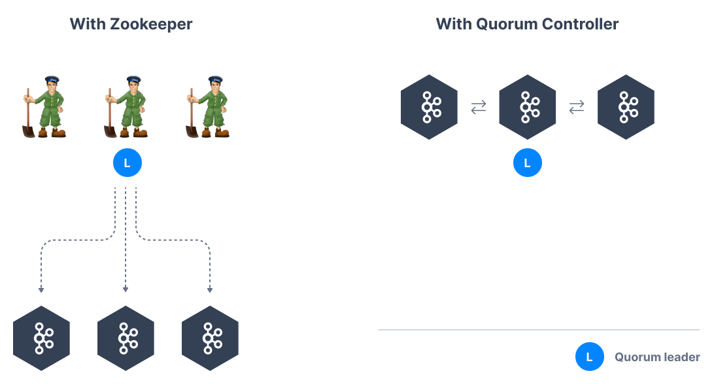

Slide 115
Why remove Zookeeper from Kafka?
Kafka clusters only support a limited number of partitions (up to 200,000)
When a Kafka broker joins or leaves a cluster, a high number of leader election must happen which can overload Zookeeper and slow down the cluster temporarily
Kafka clusters setup is difficult and depends on another component to setup
Kafka cluster metadata is sometimes out-of-sync from Zookeeper
Zookeeper security is lagging behind Kafka security.
Kafka 3.X can work (LIP-500) using Kraft mode
Kafka 4.X will not have zookeeper.

